Slide 1
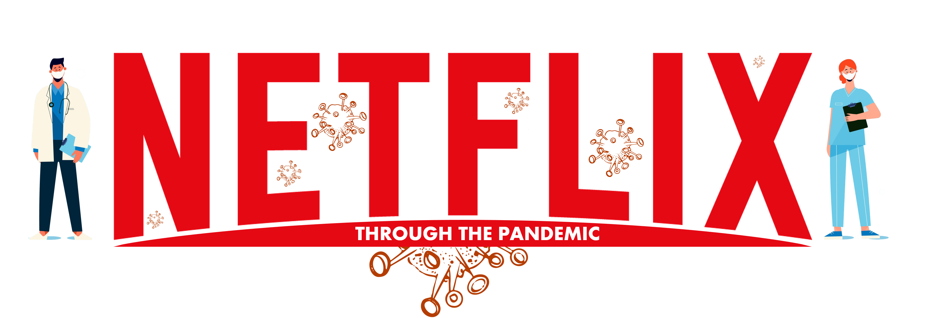

Slide 2

TEAM MEMBERS
Ji Yeol (Eric) Yang
Ali Taghipour Heidari
Hammad Ahmed
Nimra Wali
Jeremiah Sulunteh

Slide 3

Project Idea:
This project explores the impact of COVID-19 on Netflix's stock price from 2019 to 2022 through different indicators. These indicators include the number of daily cases, number of deaths.
Reason
During the pandemic, people turned to the online streaming platforms for their main sources of entertainment. Netflix was one of the online streaming giants that seemed to have profited from this trend as indicated by their soaring stock price.

Slide 4
HYPOTHESIS
Netflix performance as measured by their stock price has a significant positive relationship with COVID-19.)

Slide 5

Q1. Is there a relationship between the stock price vs. number of daily cases/death worldwide?
Q2. Is there arelationship between the stock price a week after the case count/death count vs. number of daily cases worldwide?
Q3. Is there a relationship between the stock price vs. number of daily cases/deaths by stock indicator?
Q4. Is the price movement an industry-wide trend?
compare Netflix with their main competitor Disney +
Questions

Slide 6
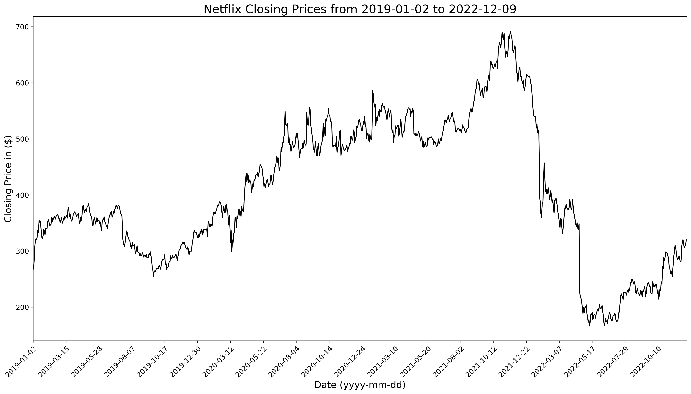
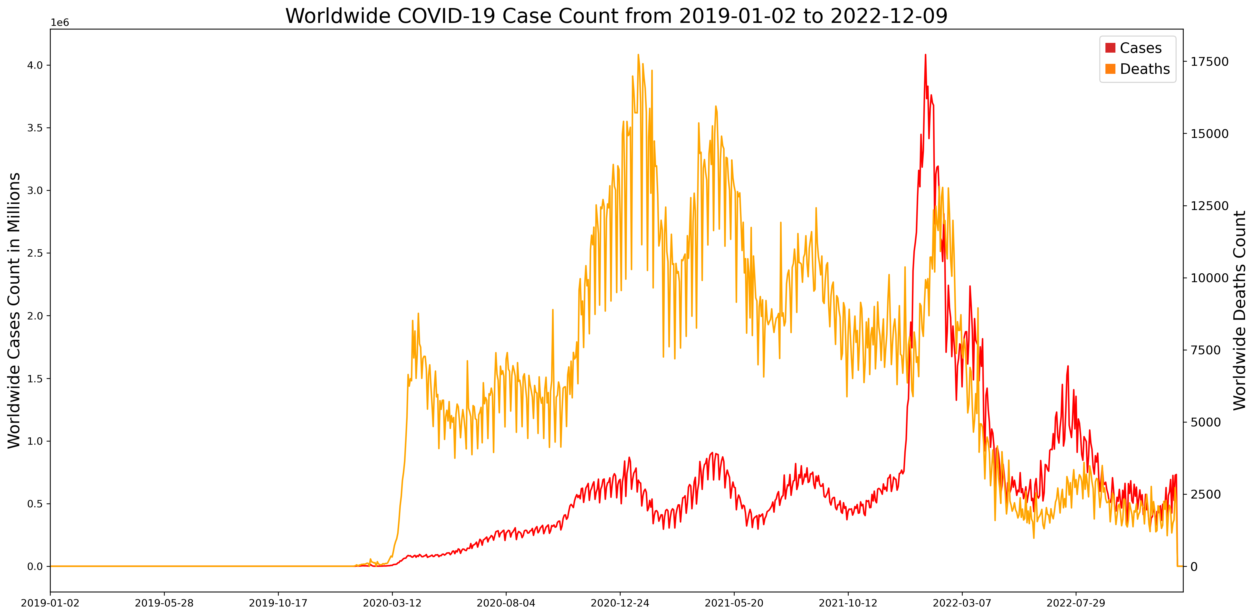
Netflix Closing Prices and Covid-19

Slide 7
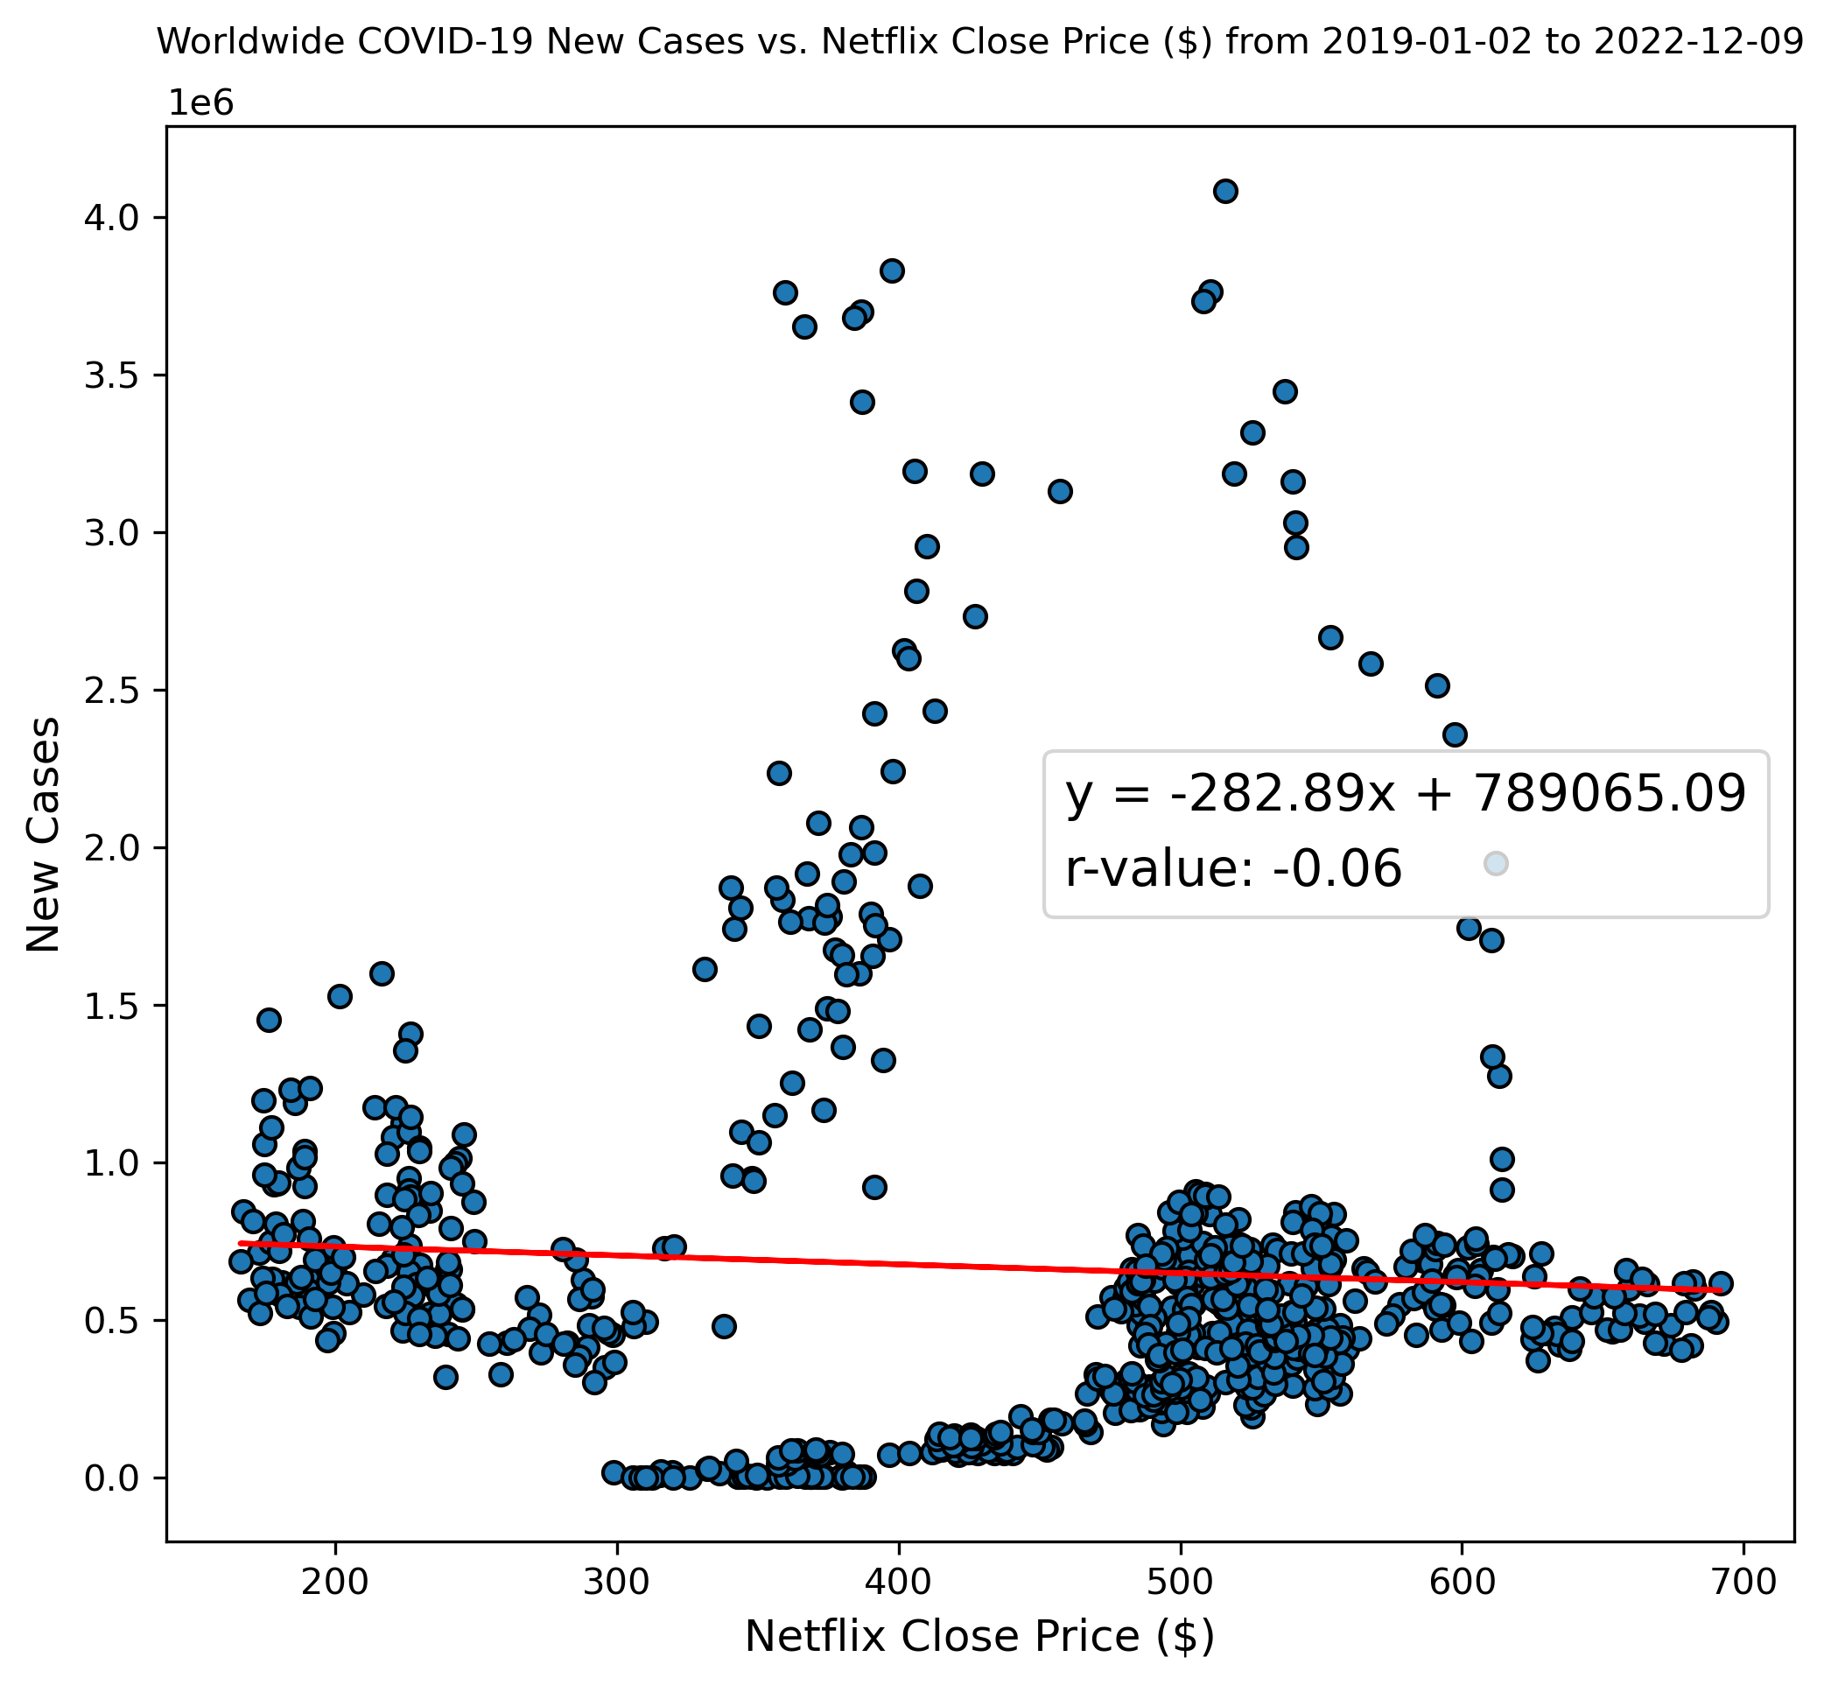
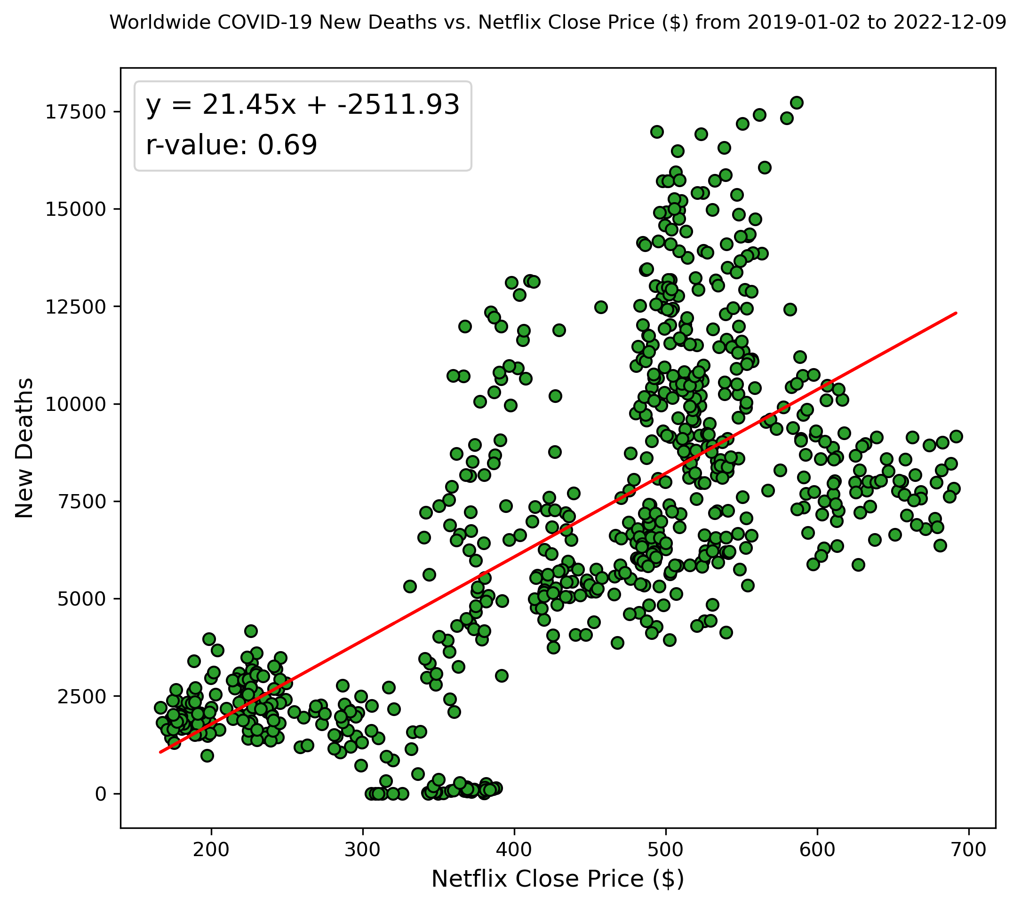
Netflix Closing Prices vs. Covid-19
Cases
R-value is -0.06 and The p-value is 0.113
Deaths
R-value is 0.69 and p-value is 0.0

Slide 8
Q1. Is there a relationship between the stock price vs. number of daily cases/death worldwide?
Q2. Is there a relationship between the stock price a week after the case count/death count vs. number of daily cases worldwide?
Q3. Is there a relationship between the stock price vs. number of daily cases/deaths by stock indicator?
Q4. Is the price movement an industry-wide trend?
compare Netflix with their main competitor Disney +
Questions

Slide 9

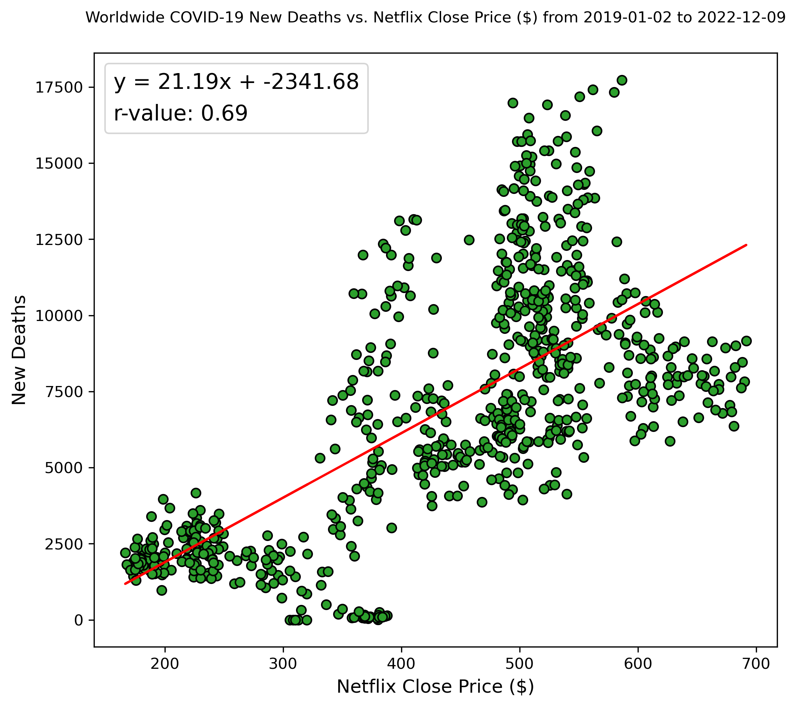
Netflix Closing Prices vs. Covid-19 (week after)
Cases
R-value is -0.07 and The p-value is 0.0726
Deaths
R-value is 0.69 and p-value is 0.0

Slide 10
Q1. Is there a relationship between the stock price vs. number of daily cases/death worldwide?
Q2. Is there a relationship between the stock price a week after the case count/death count vs. number of daily cases worldwide?
Q3. Is there a relationship between the stock price vs. number of daily cases/deaths by stock indicator?
Q4. Is the price movement an industry-wide trend?
compare Netflix with their main competitor Disney +
Questions

Slide 11
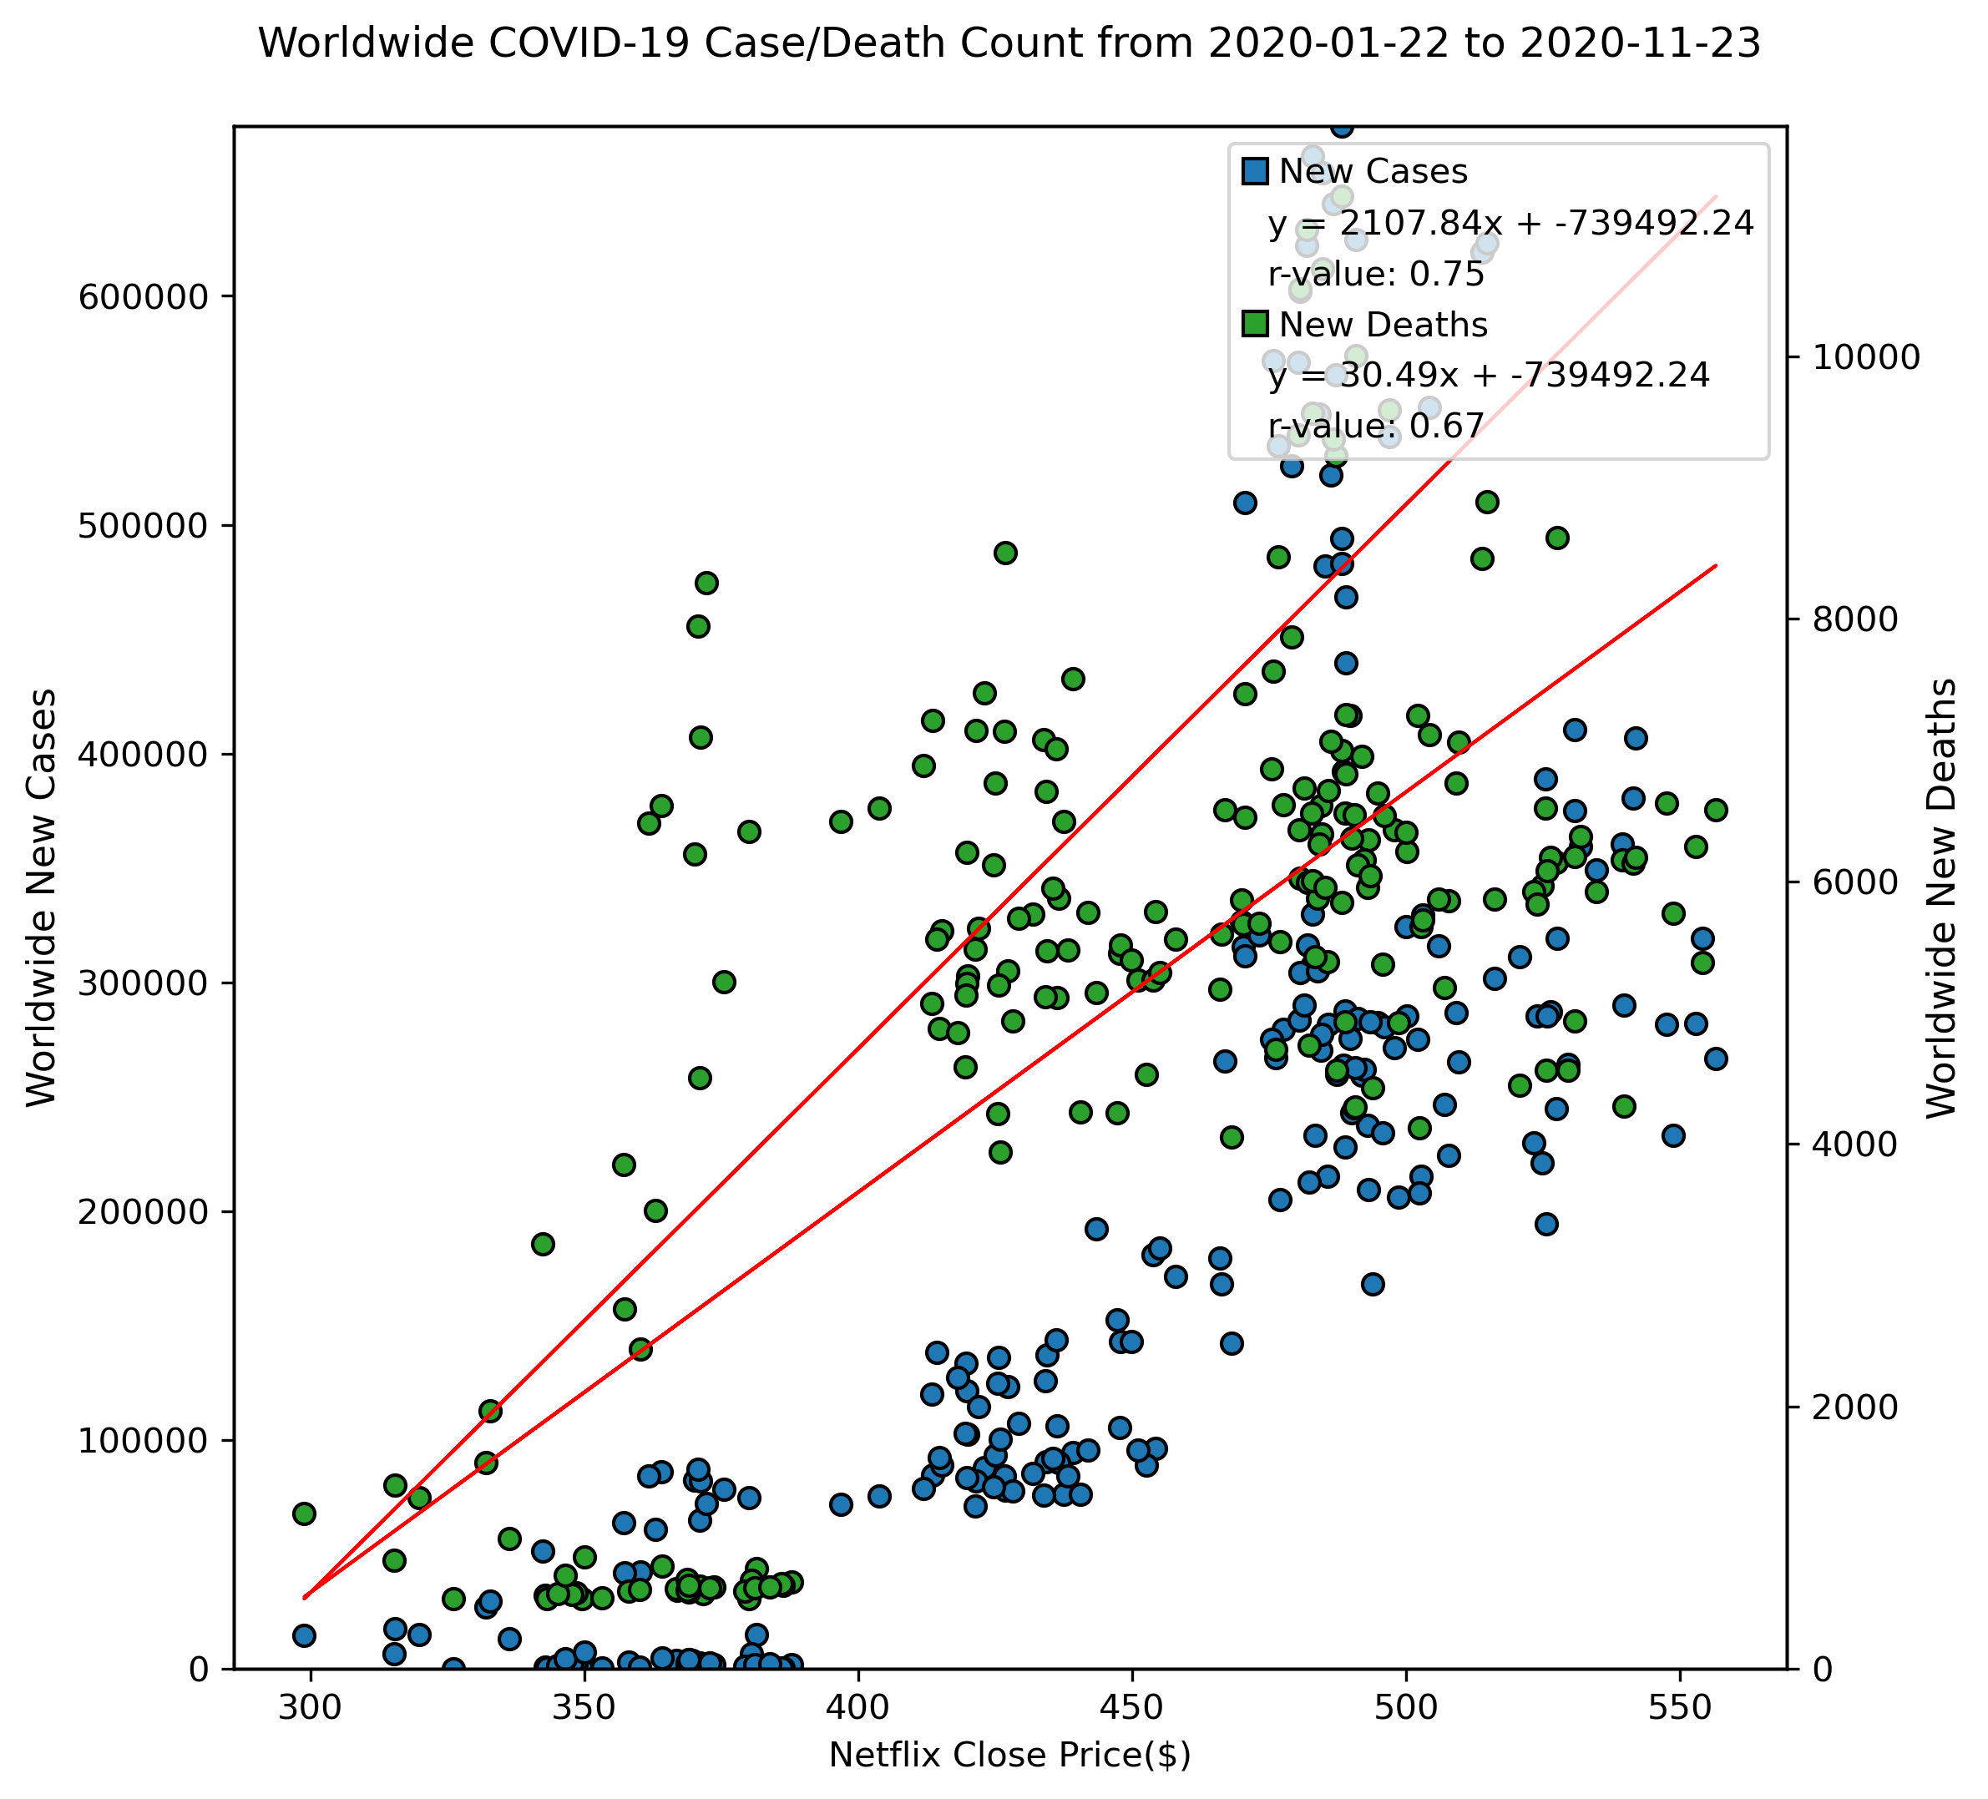
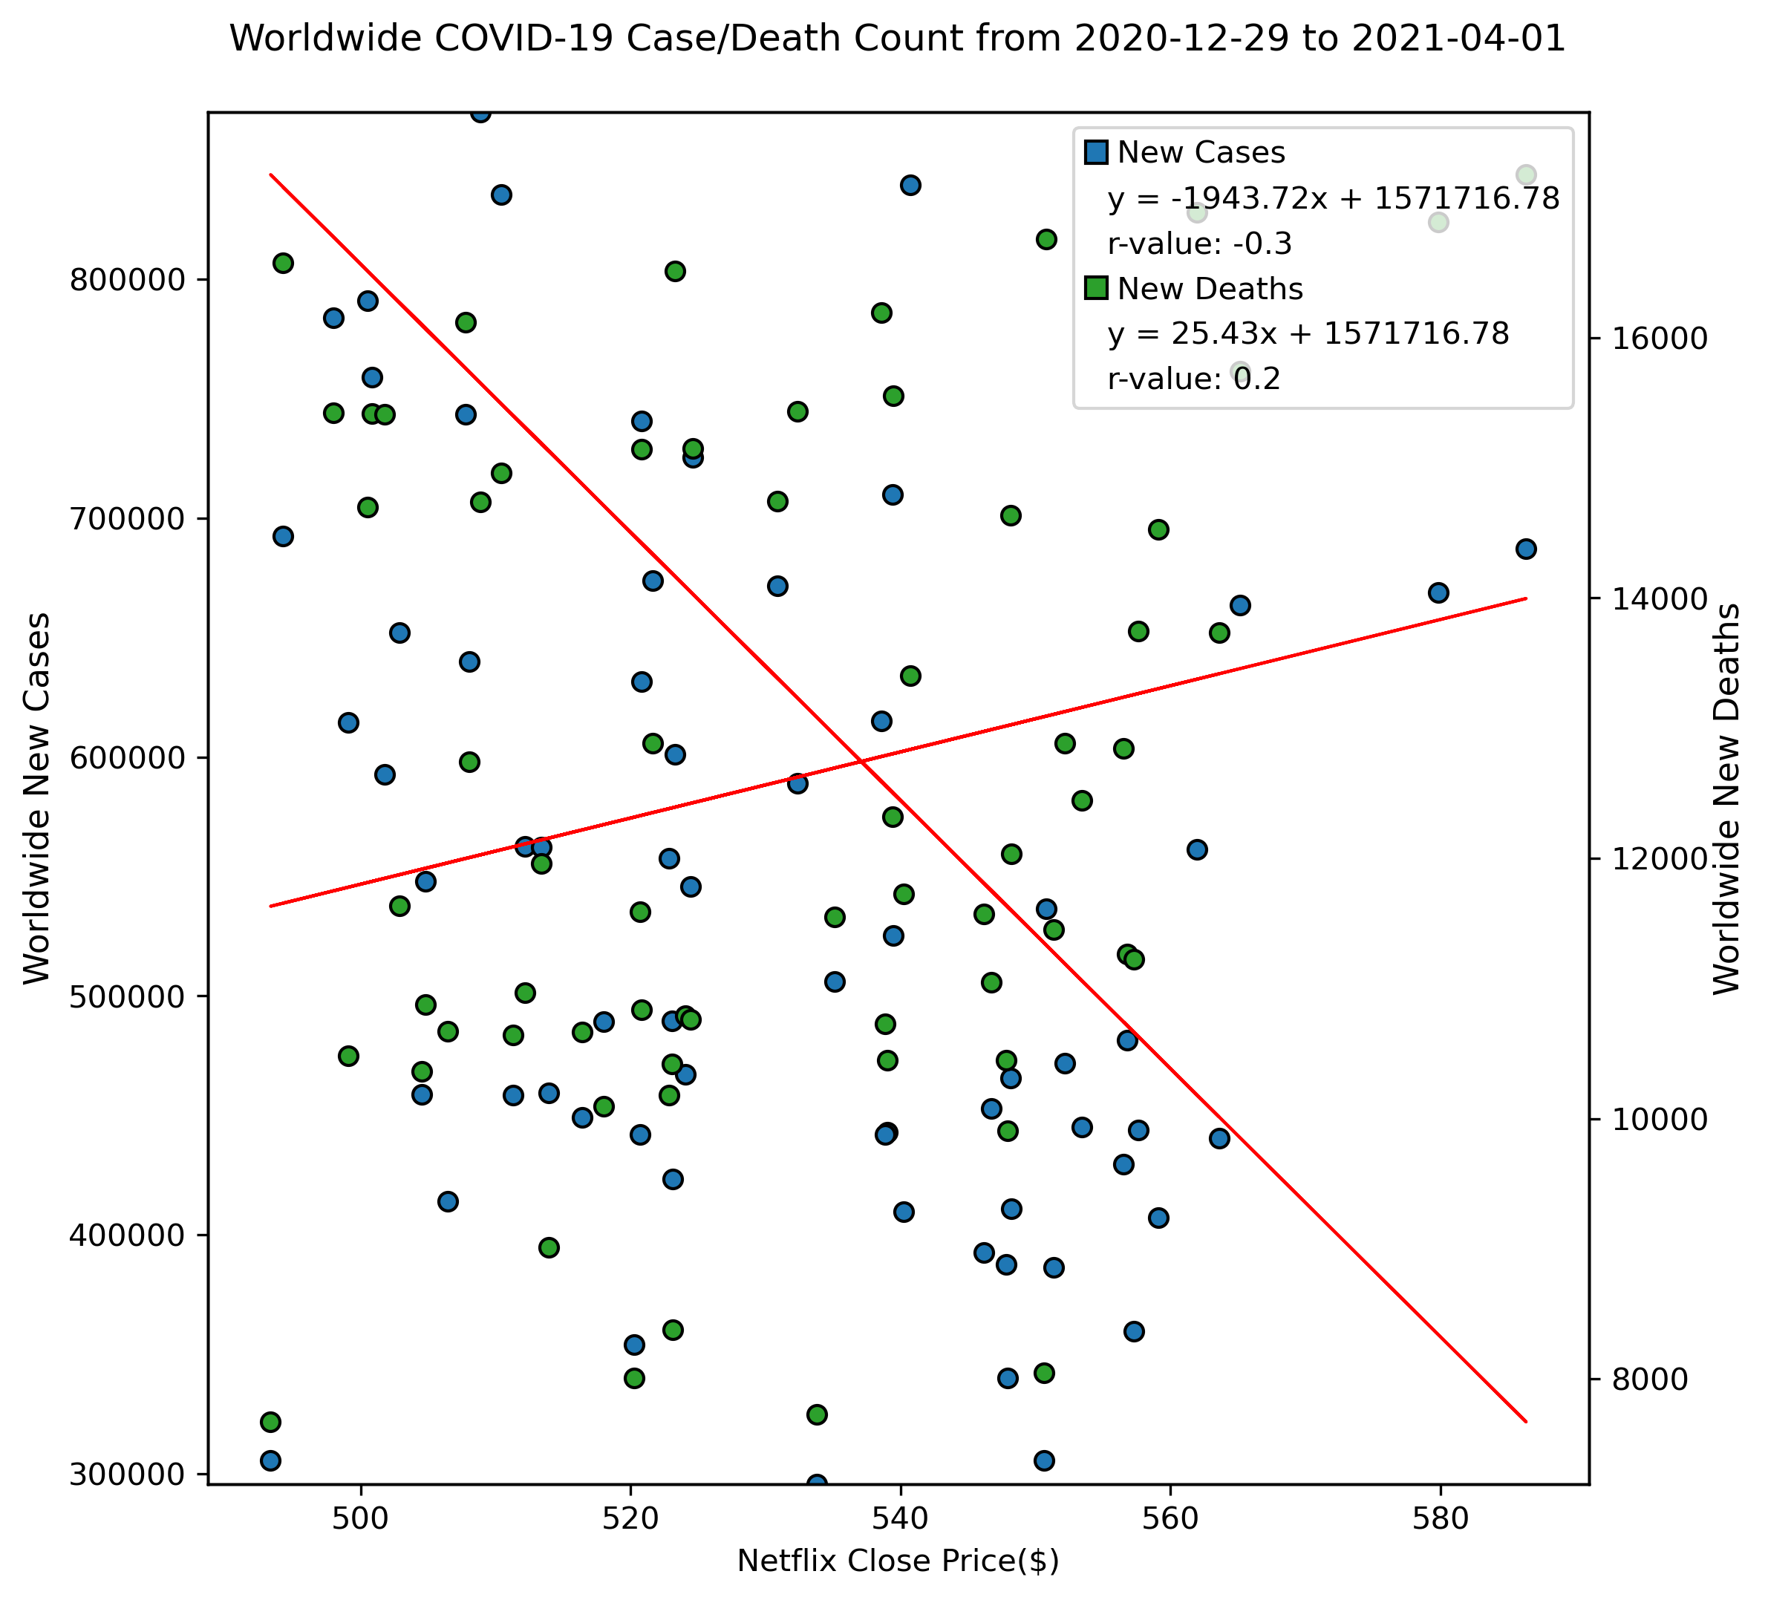
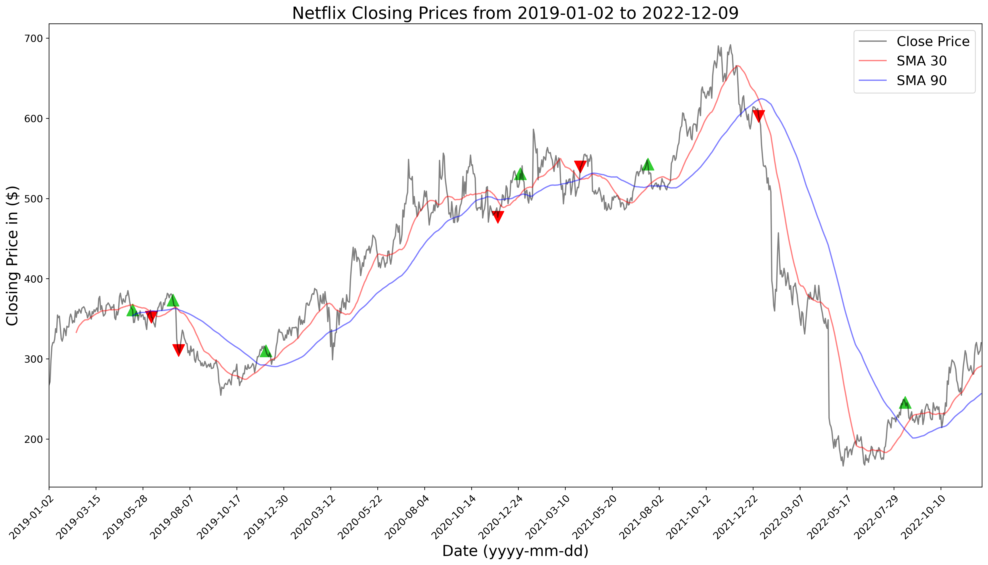
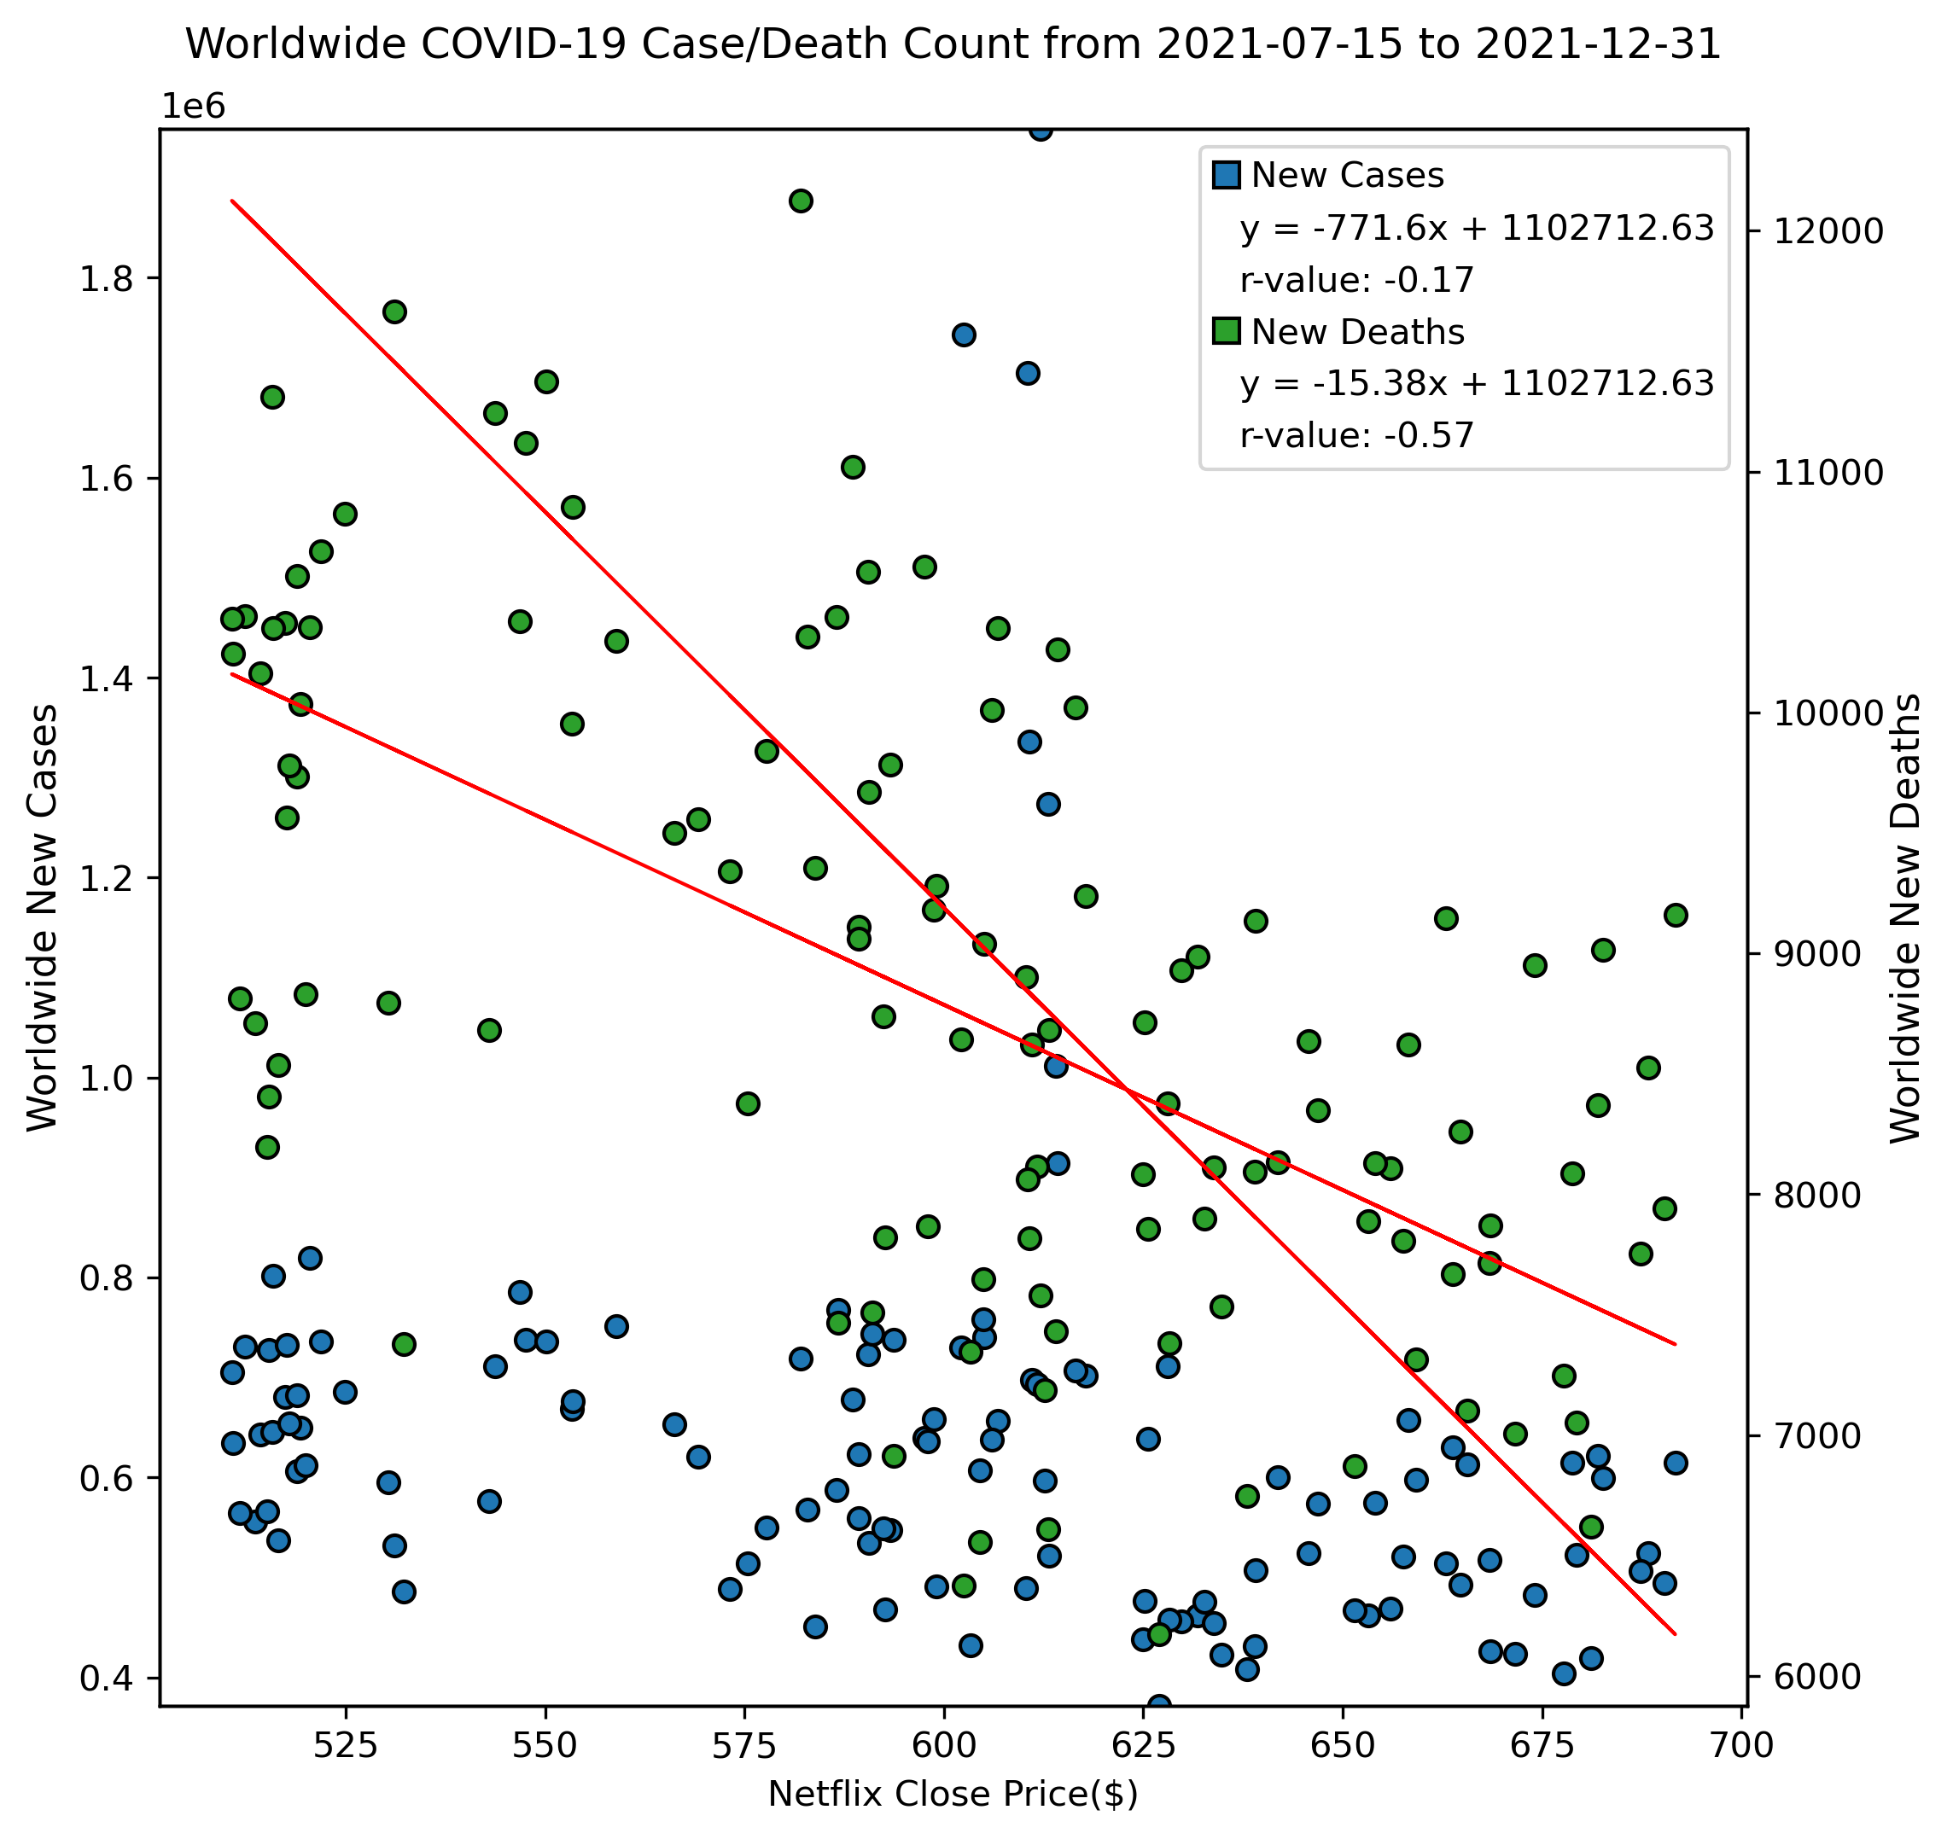
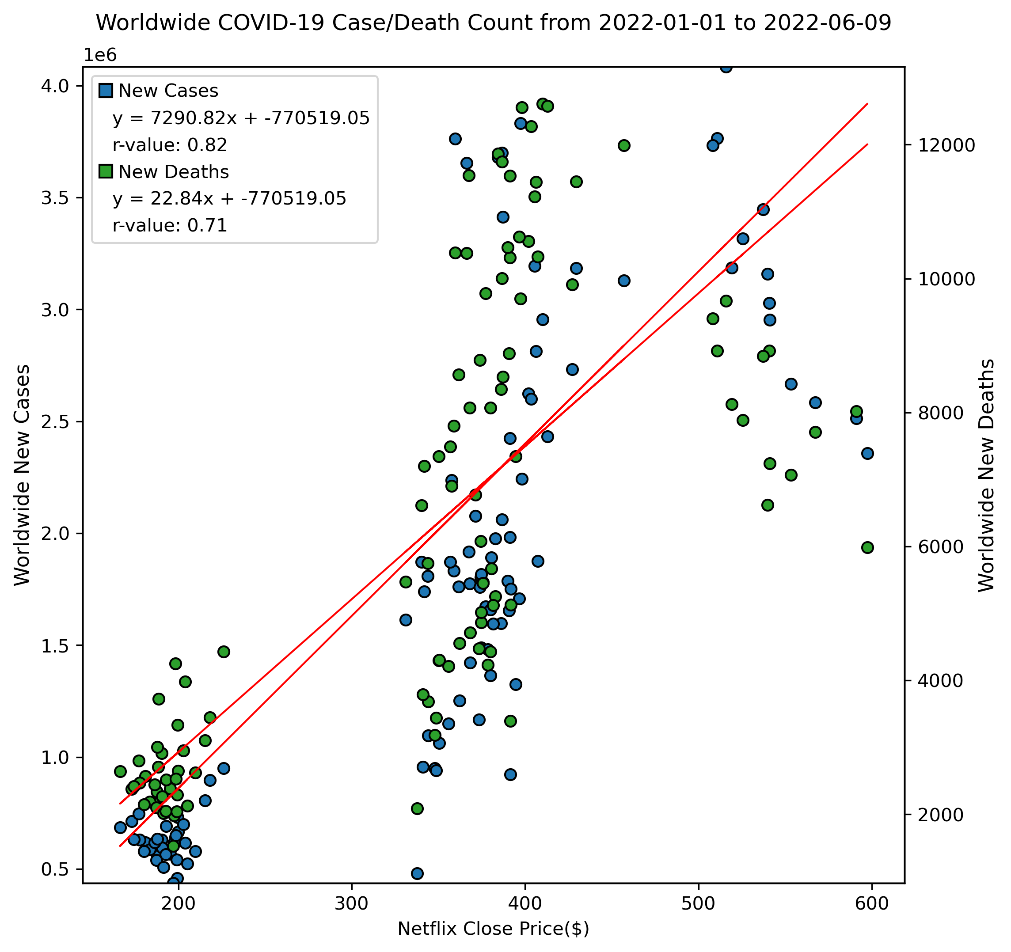
Netflix Closing Prices vs. Covid-19 (stock indicator)
1. SMA (Simple Moving Average) Indicator

Slide 12
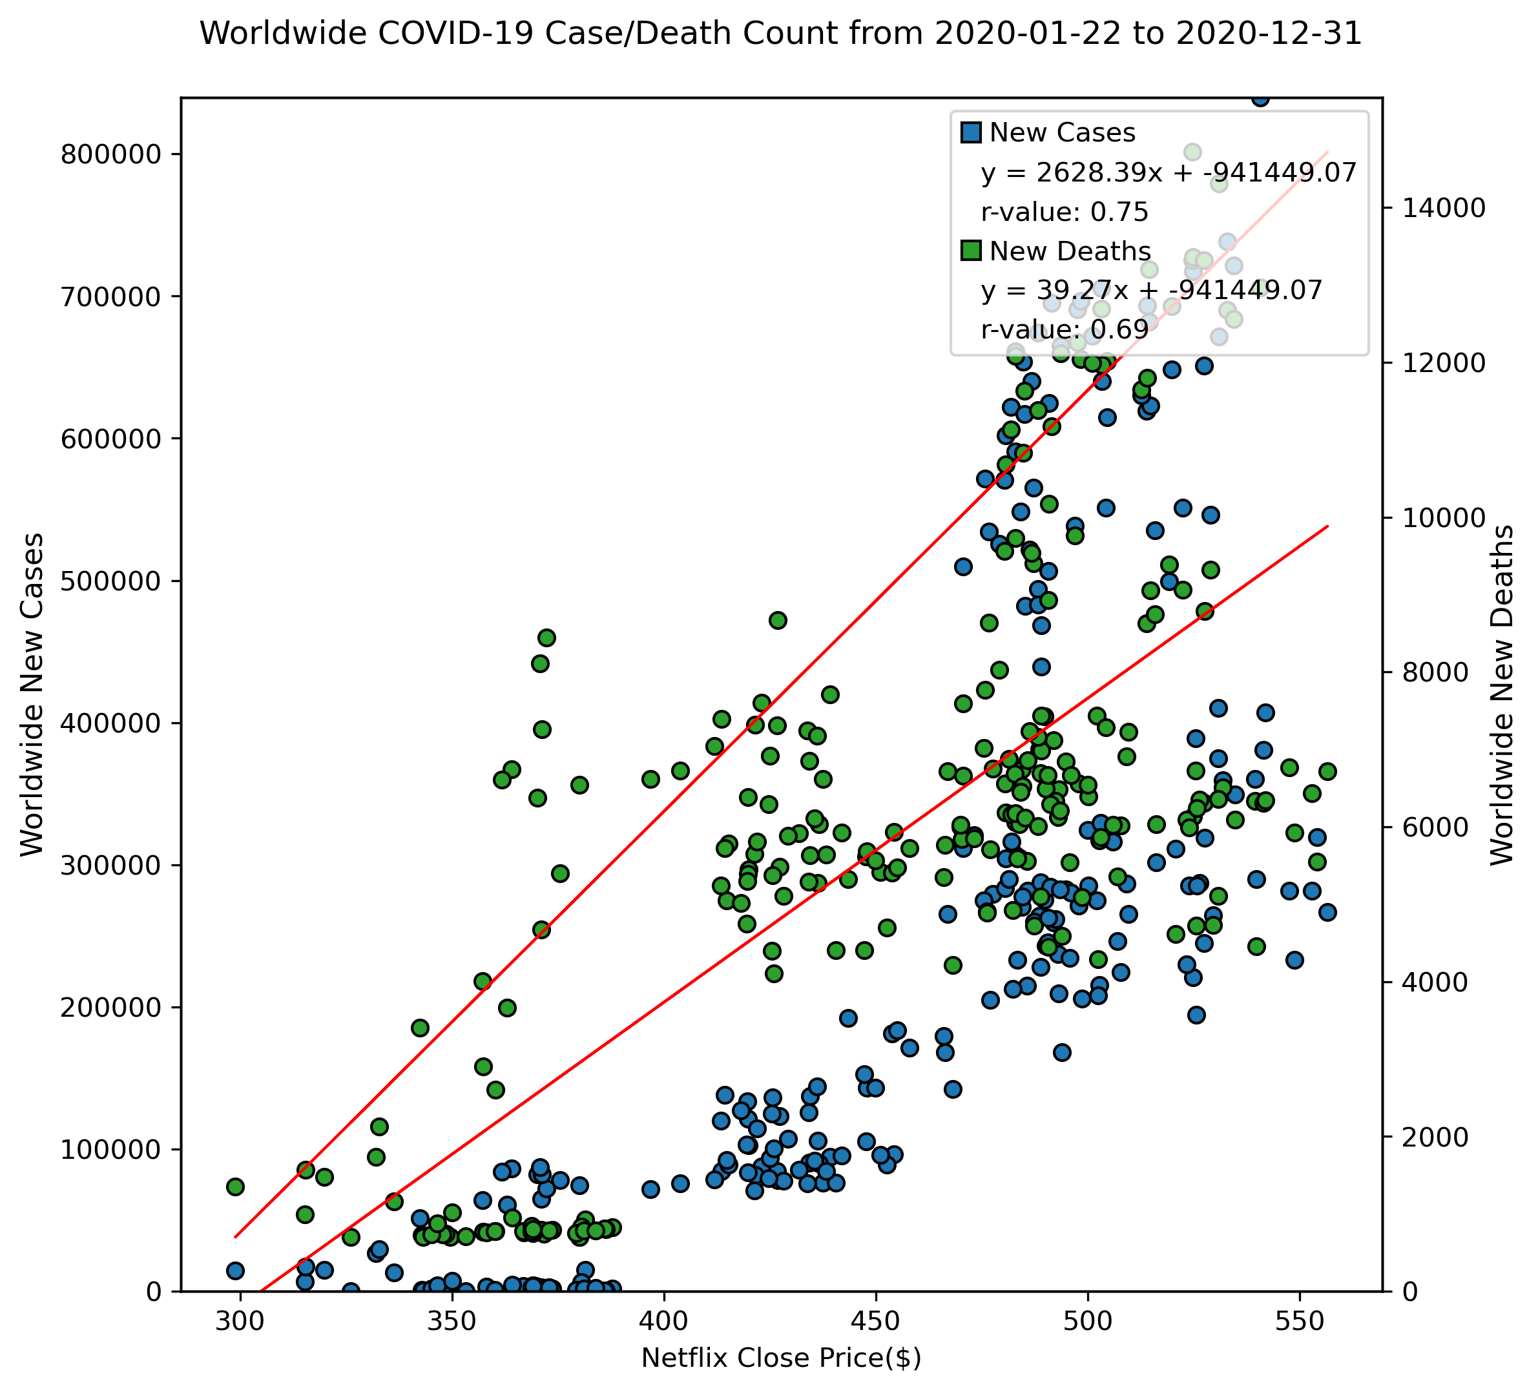
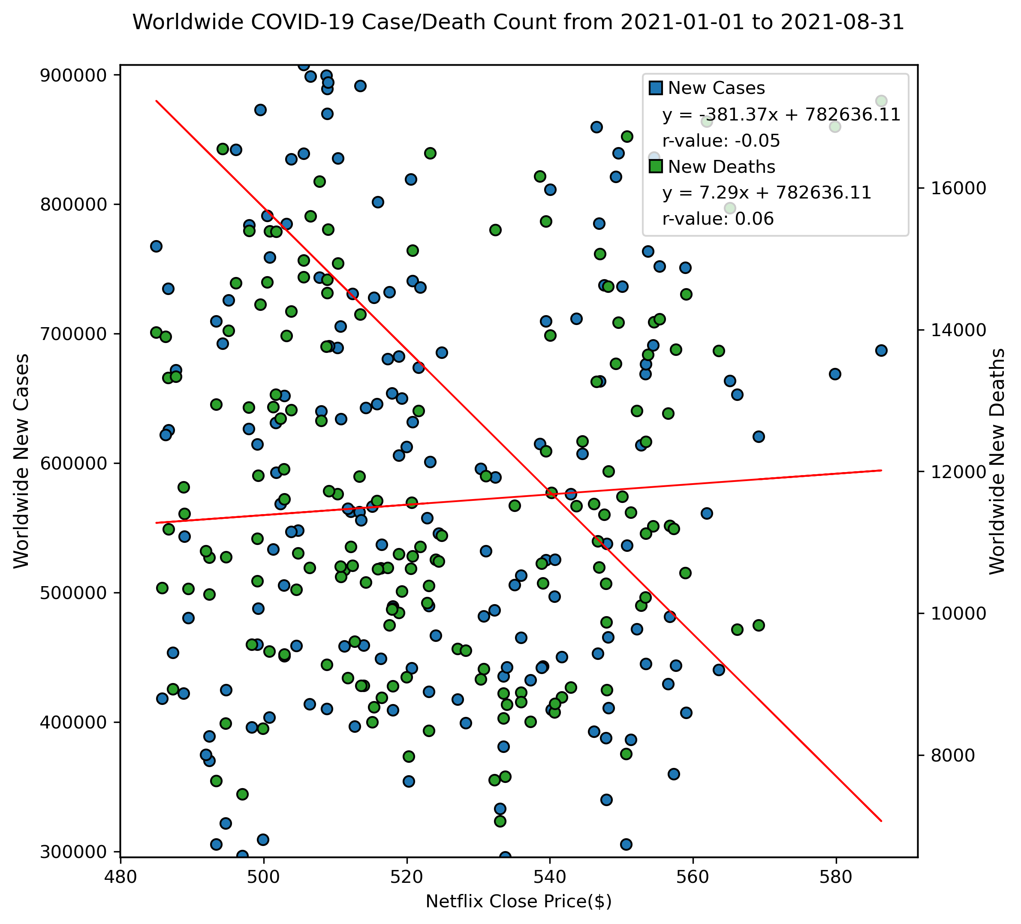
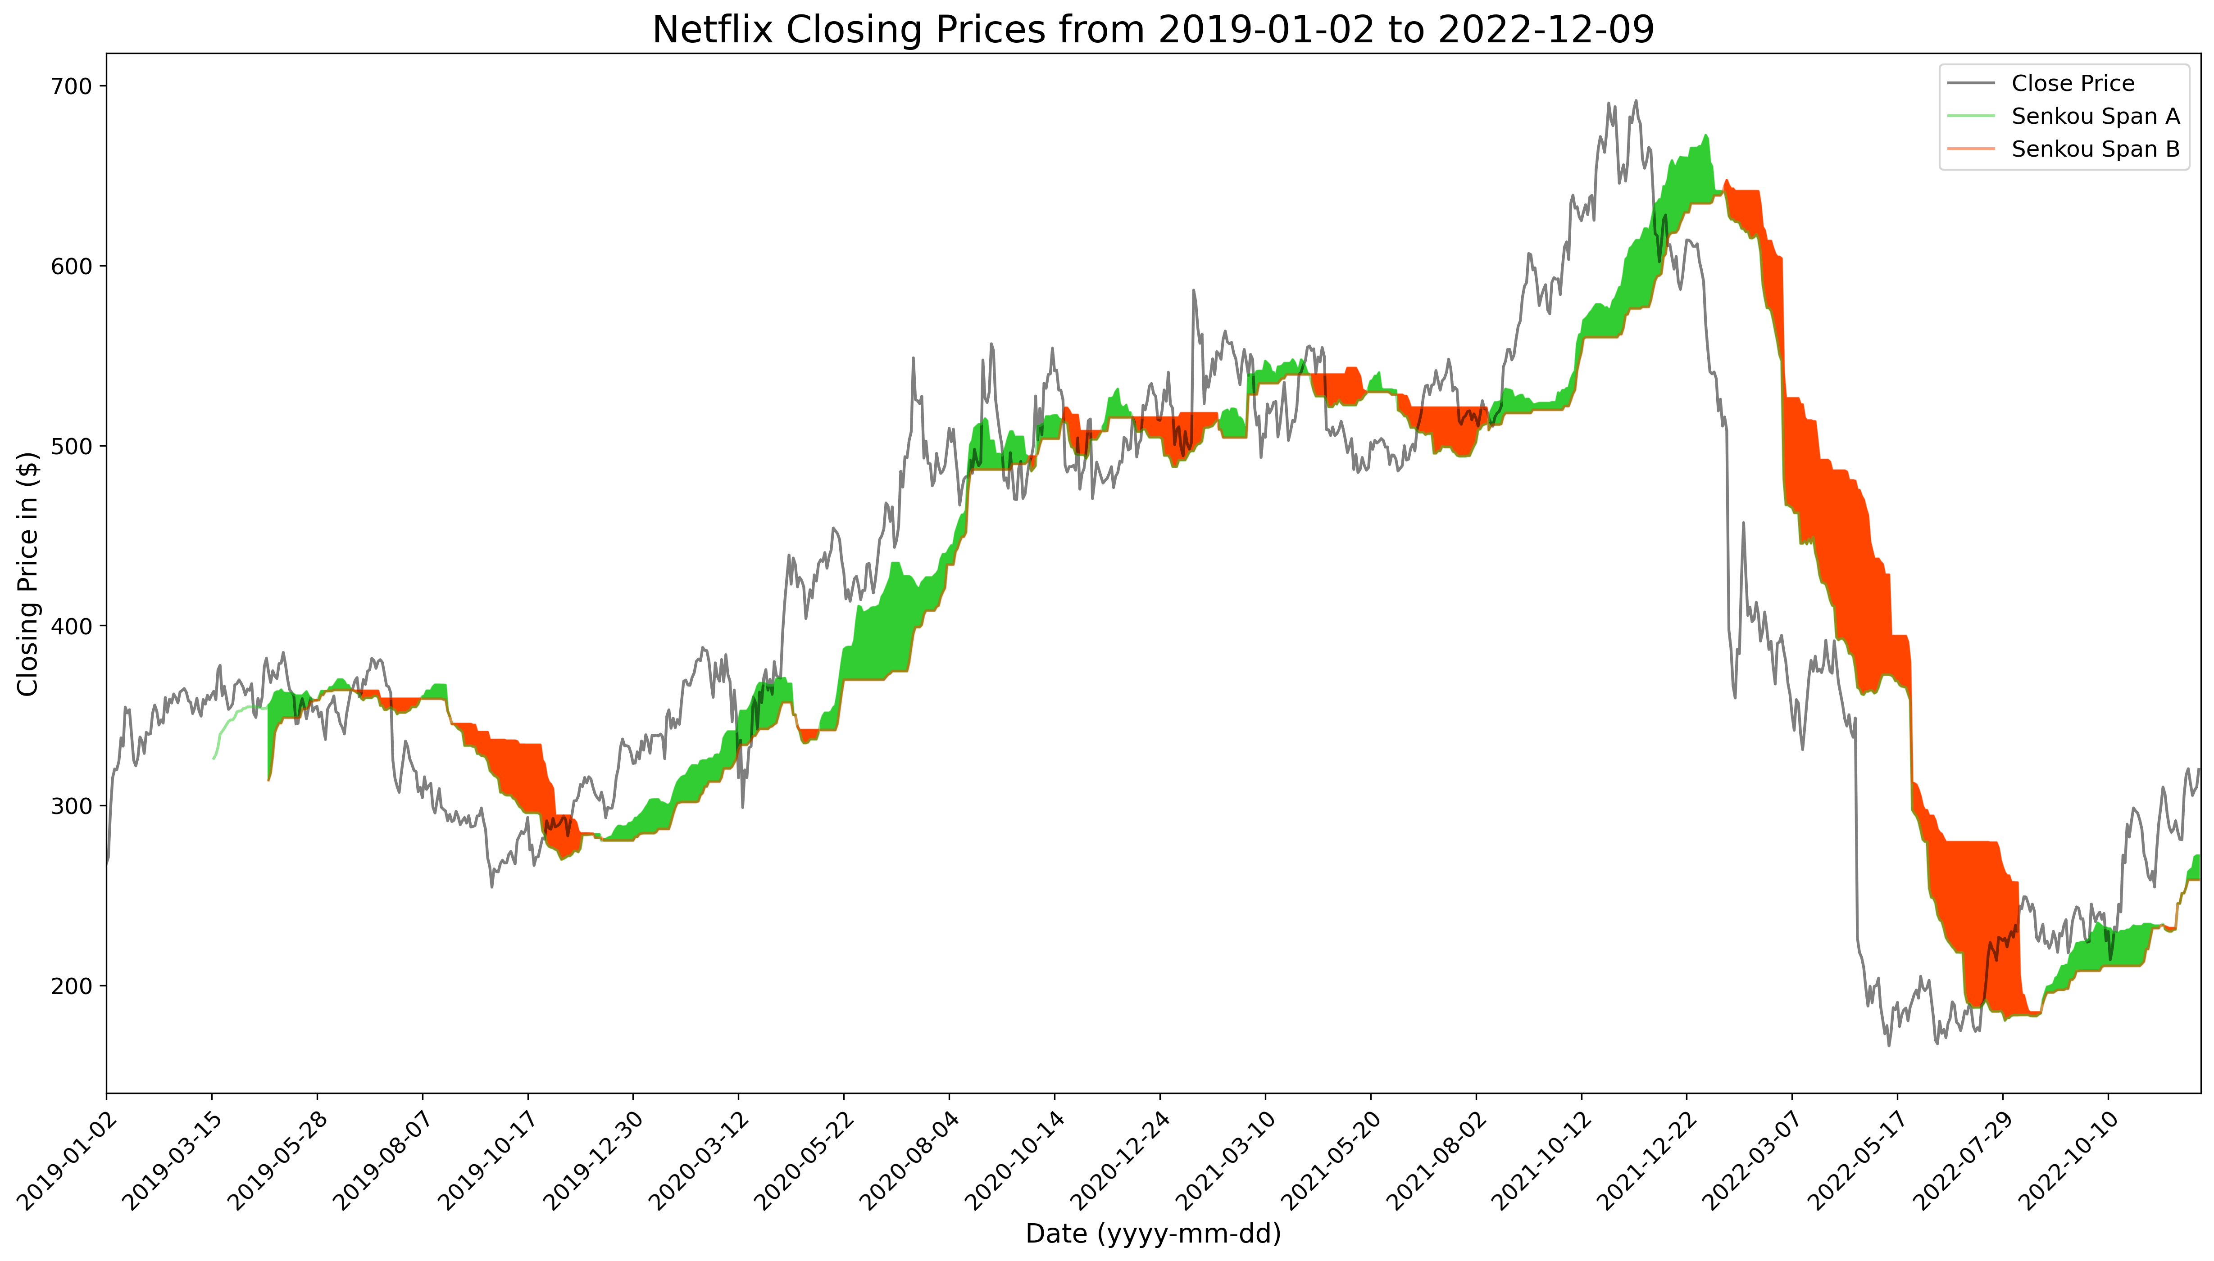
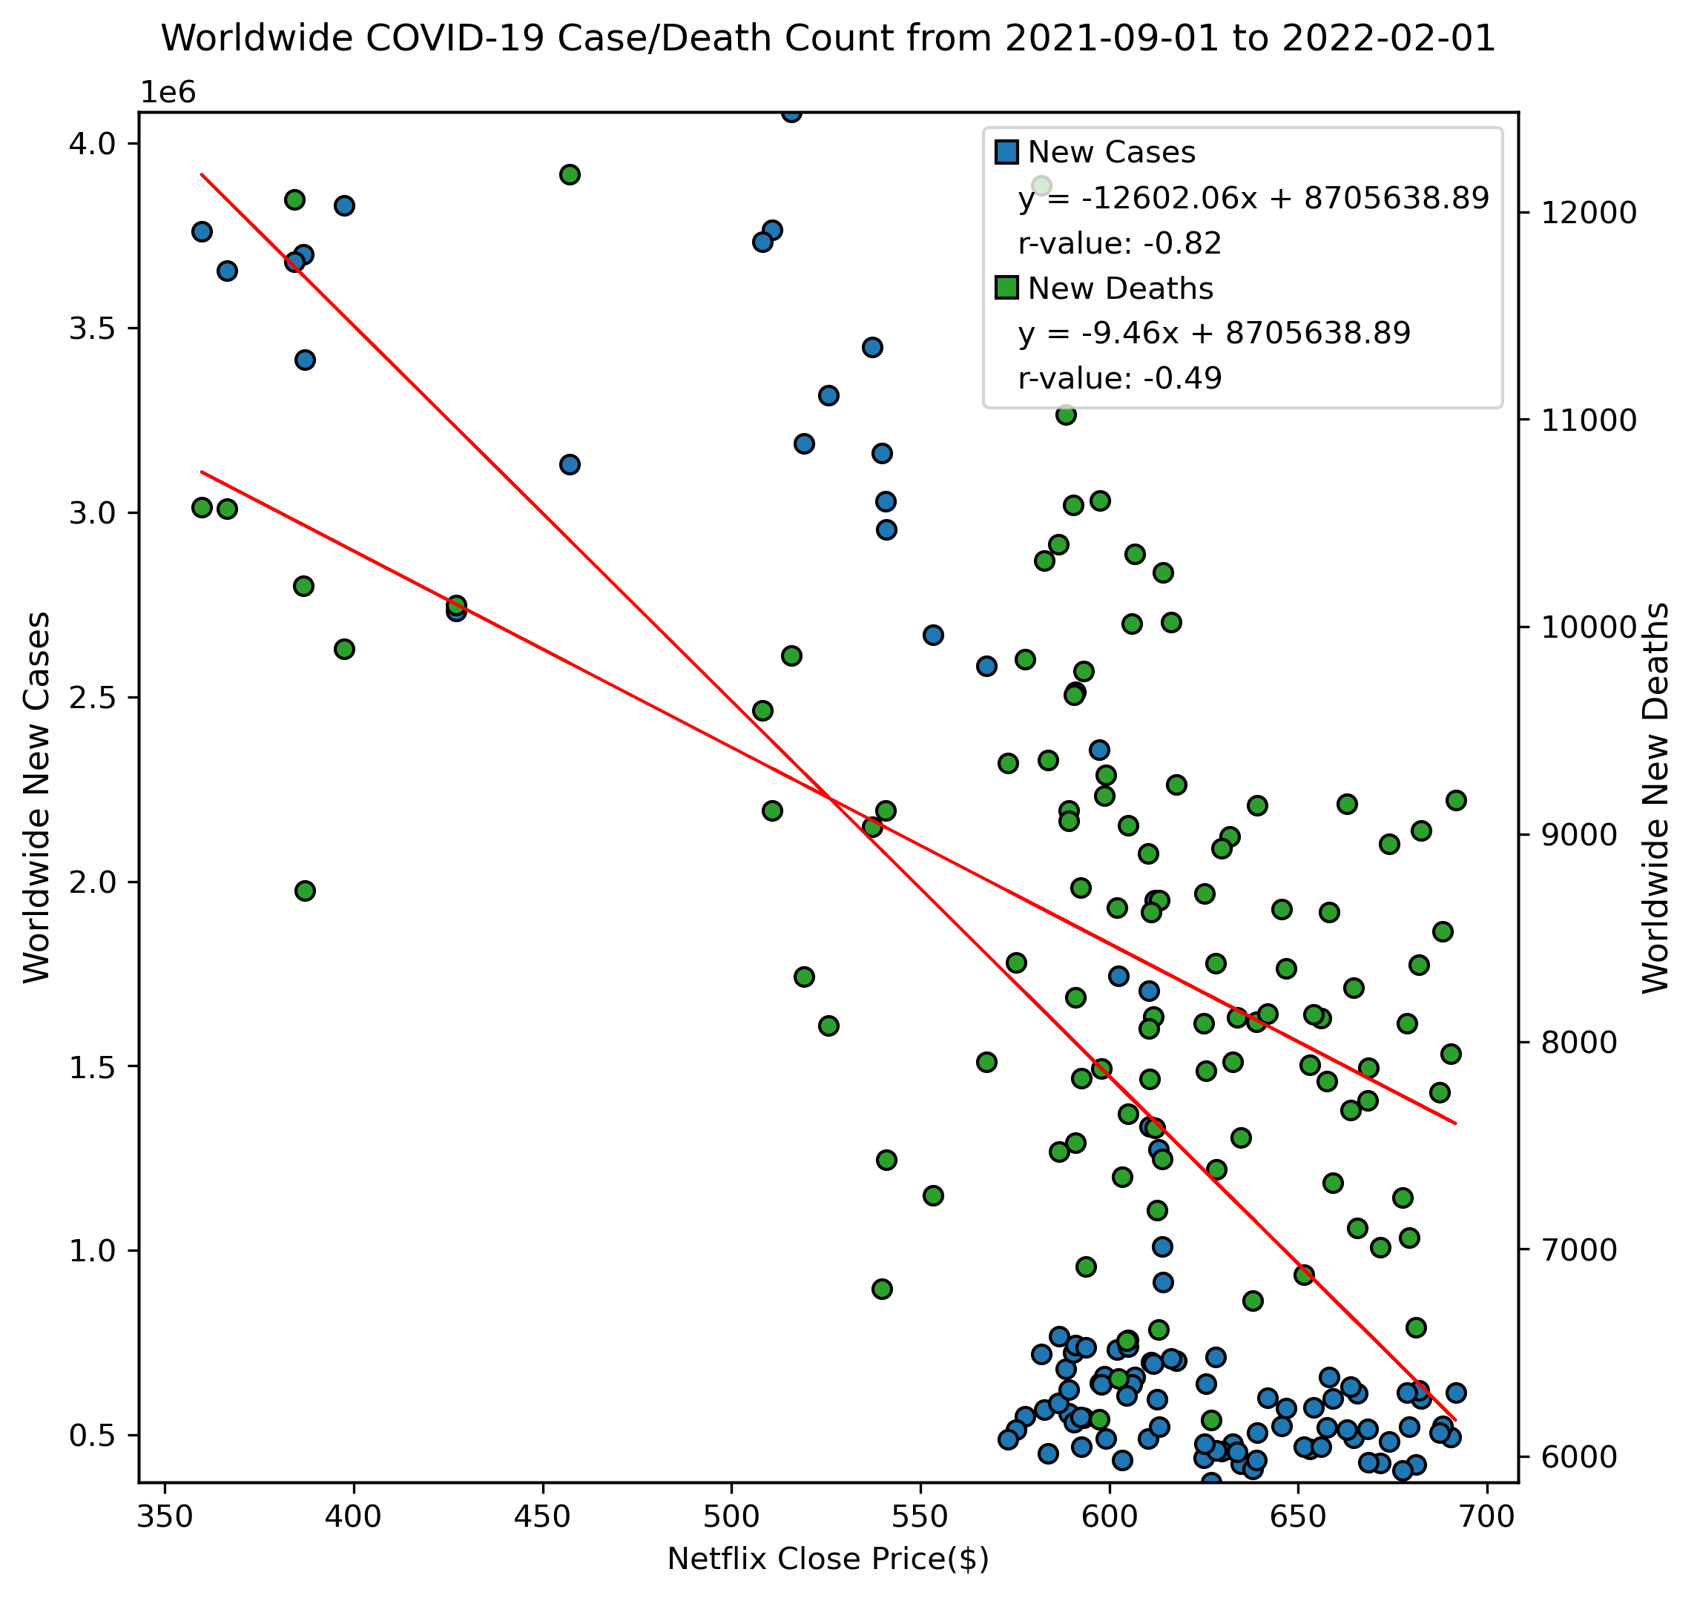
Netflix Closing Prices vs. Covid-19 (stock indicator)
2. IchimokuCloud Indicator

Slide 13
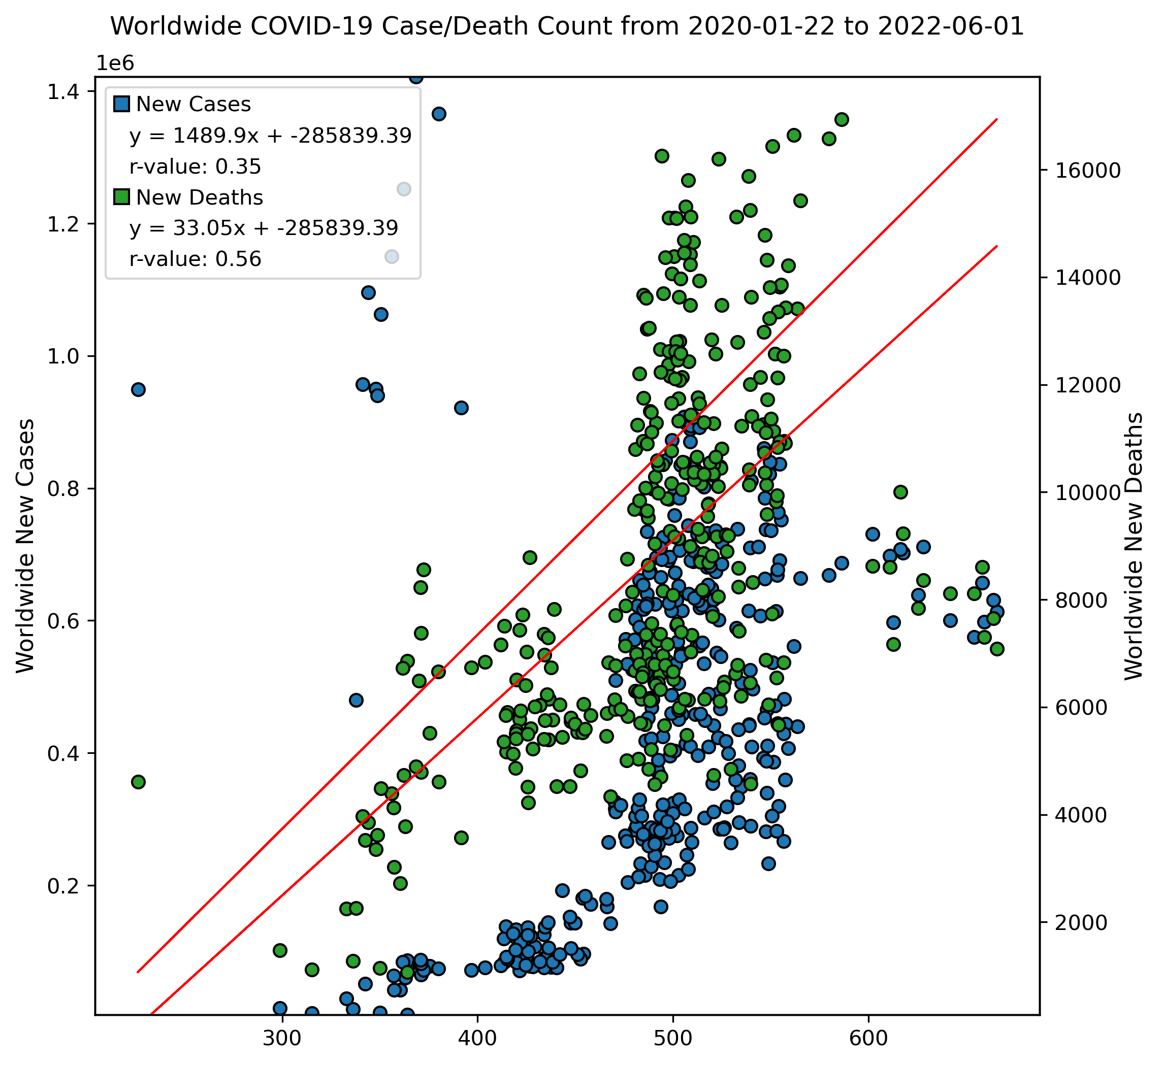
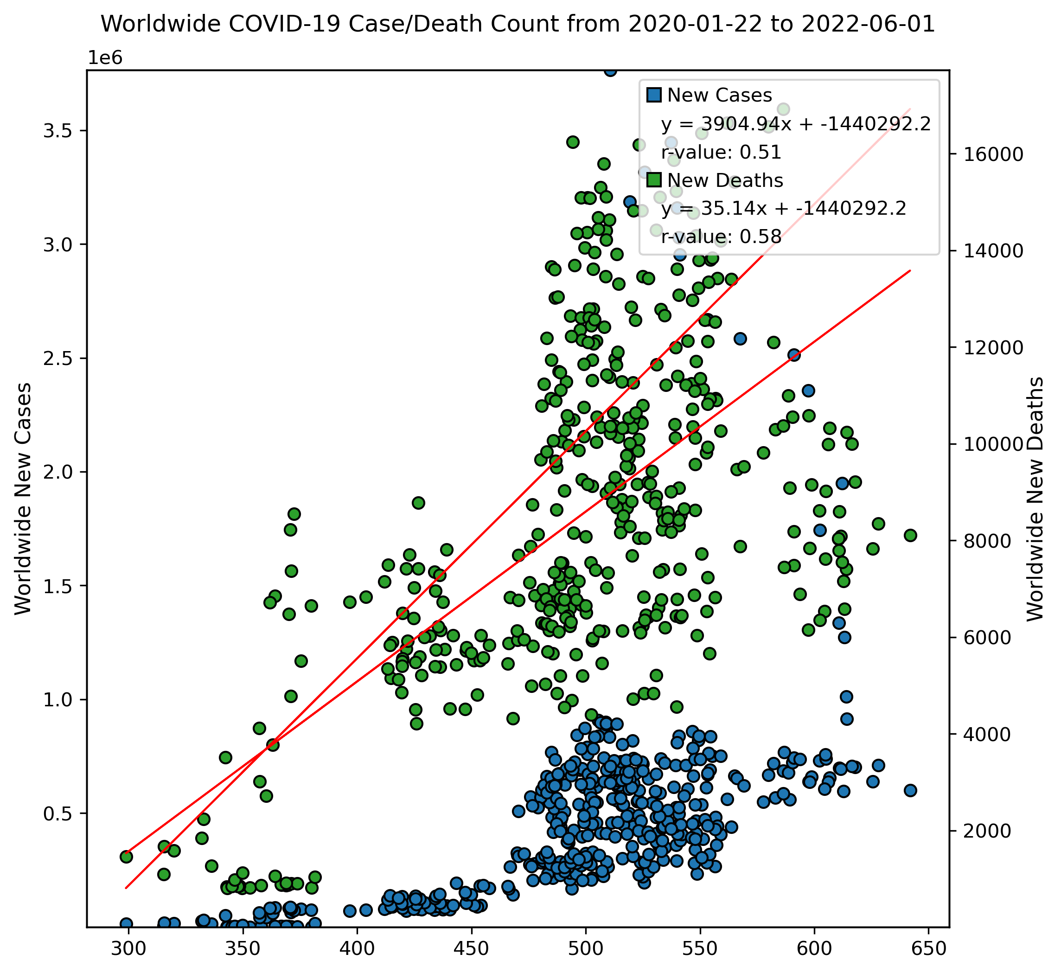
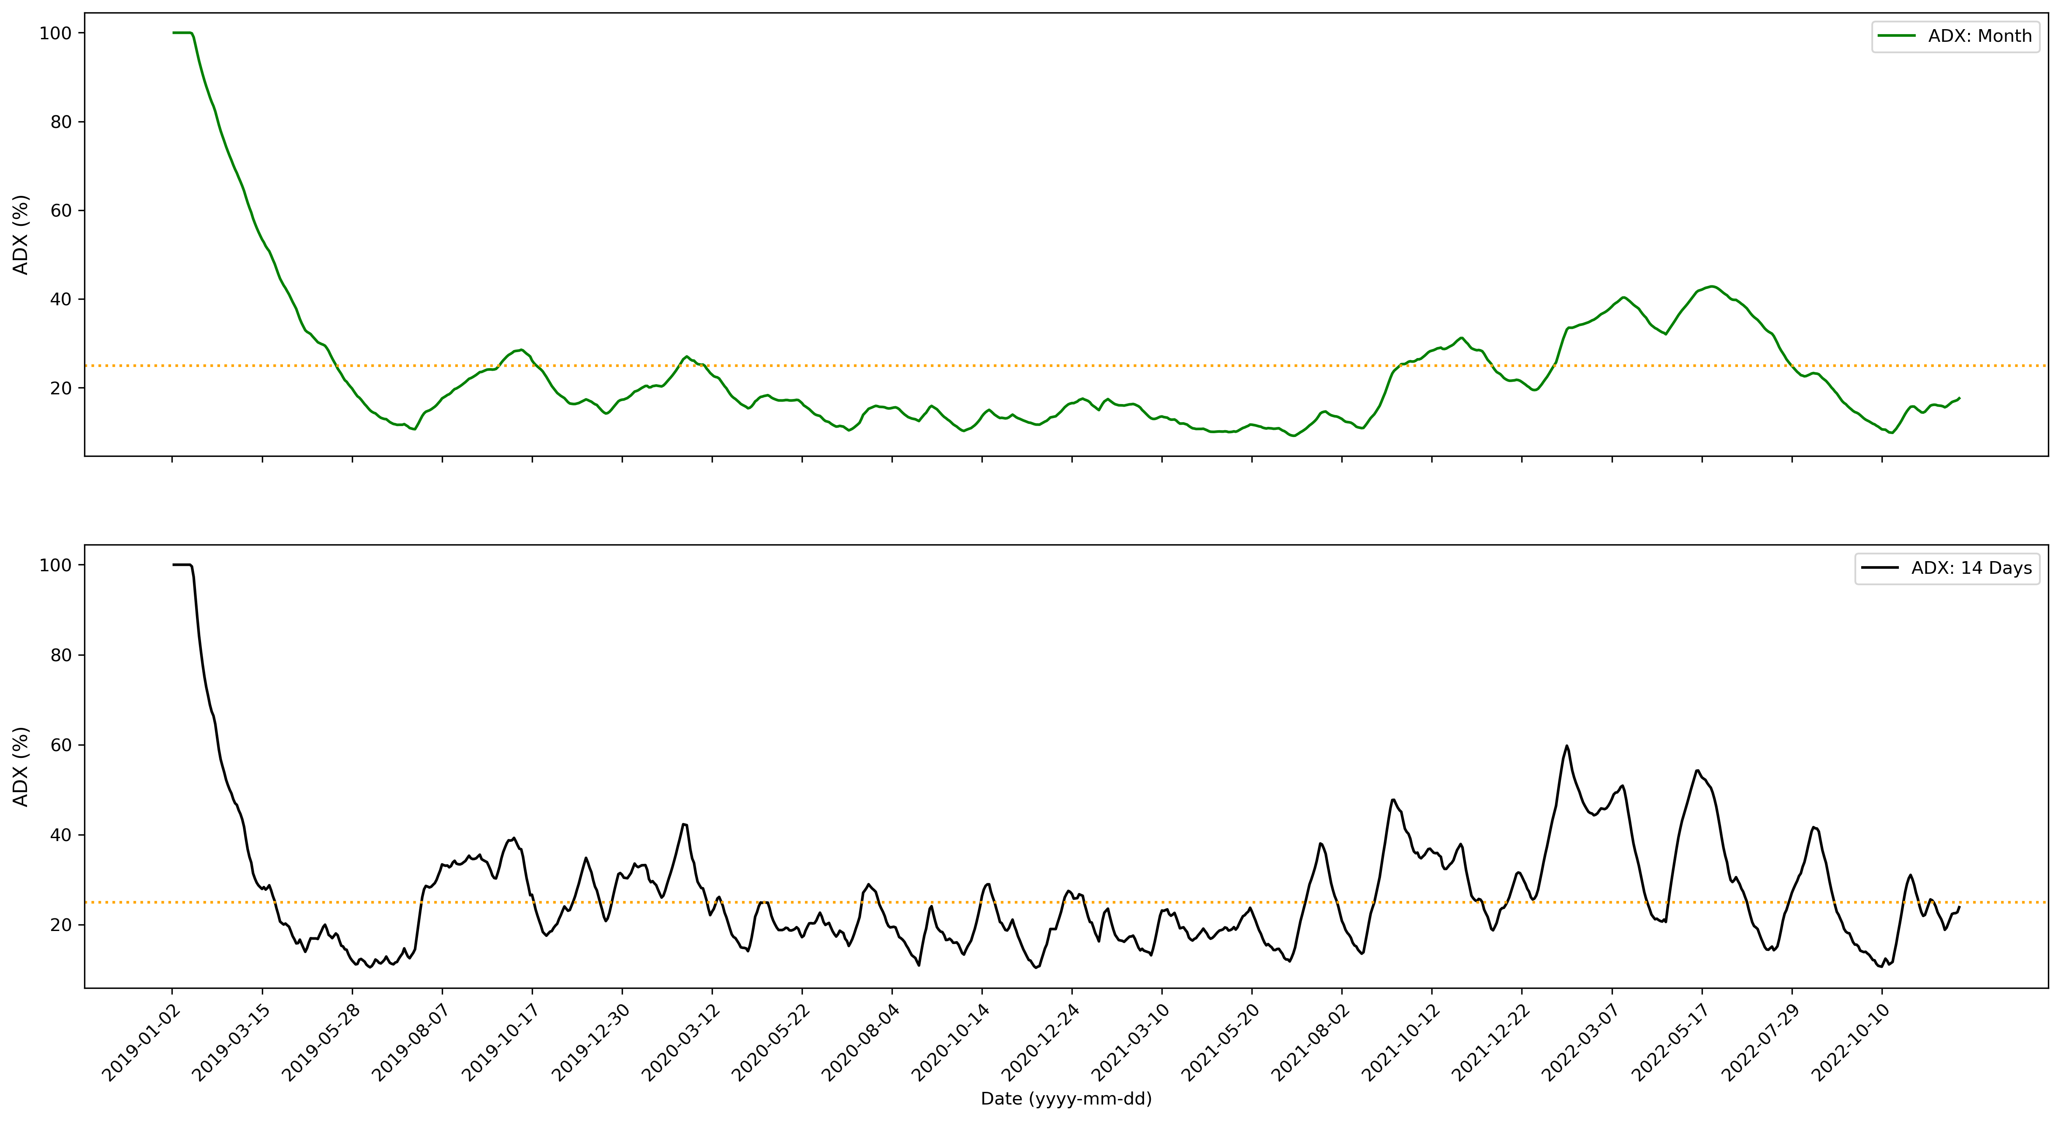
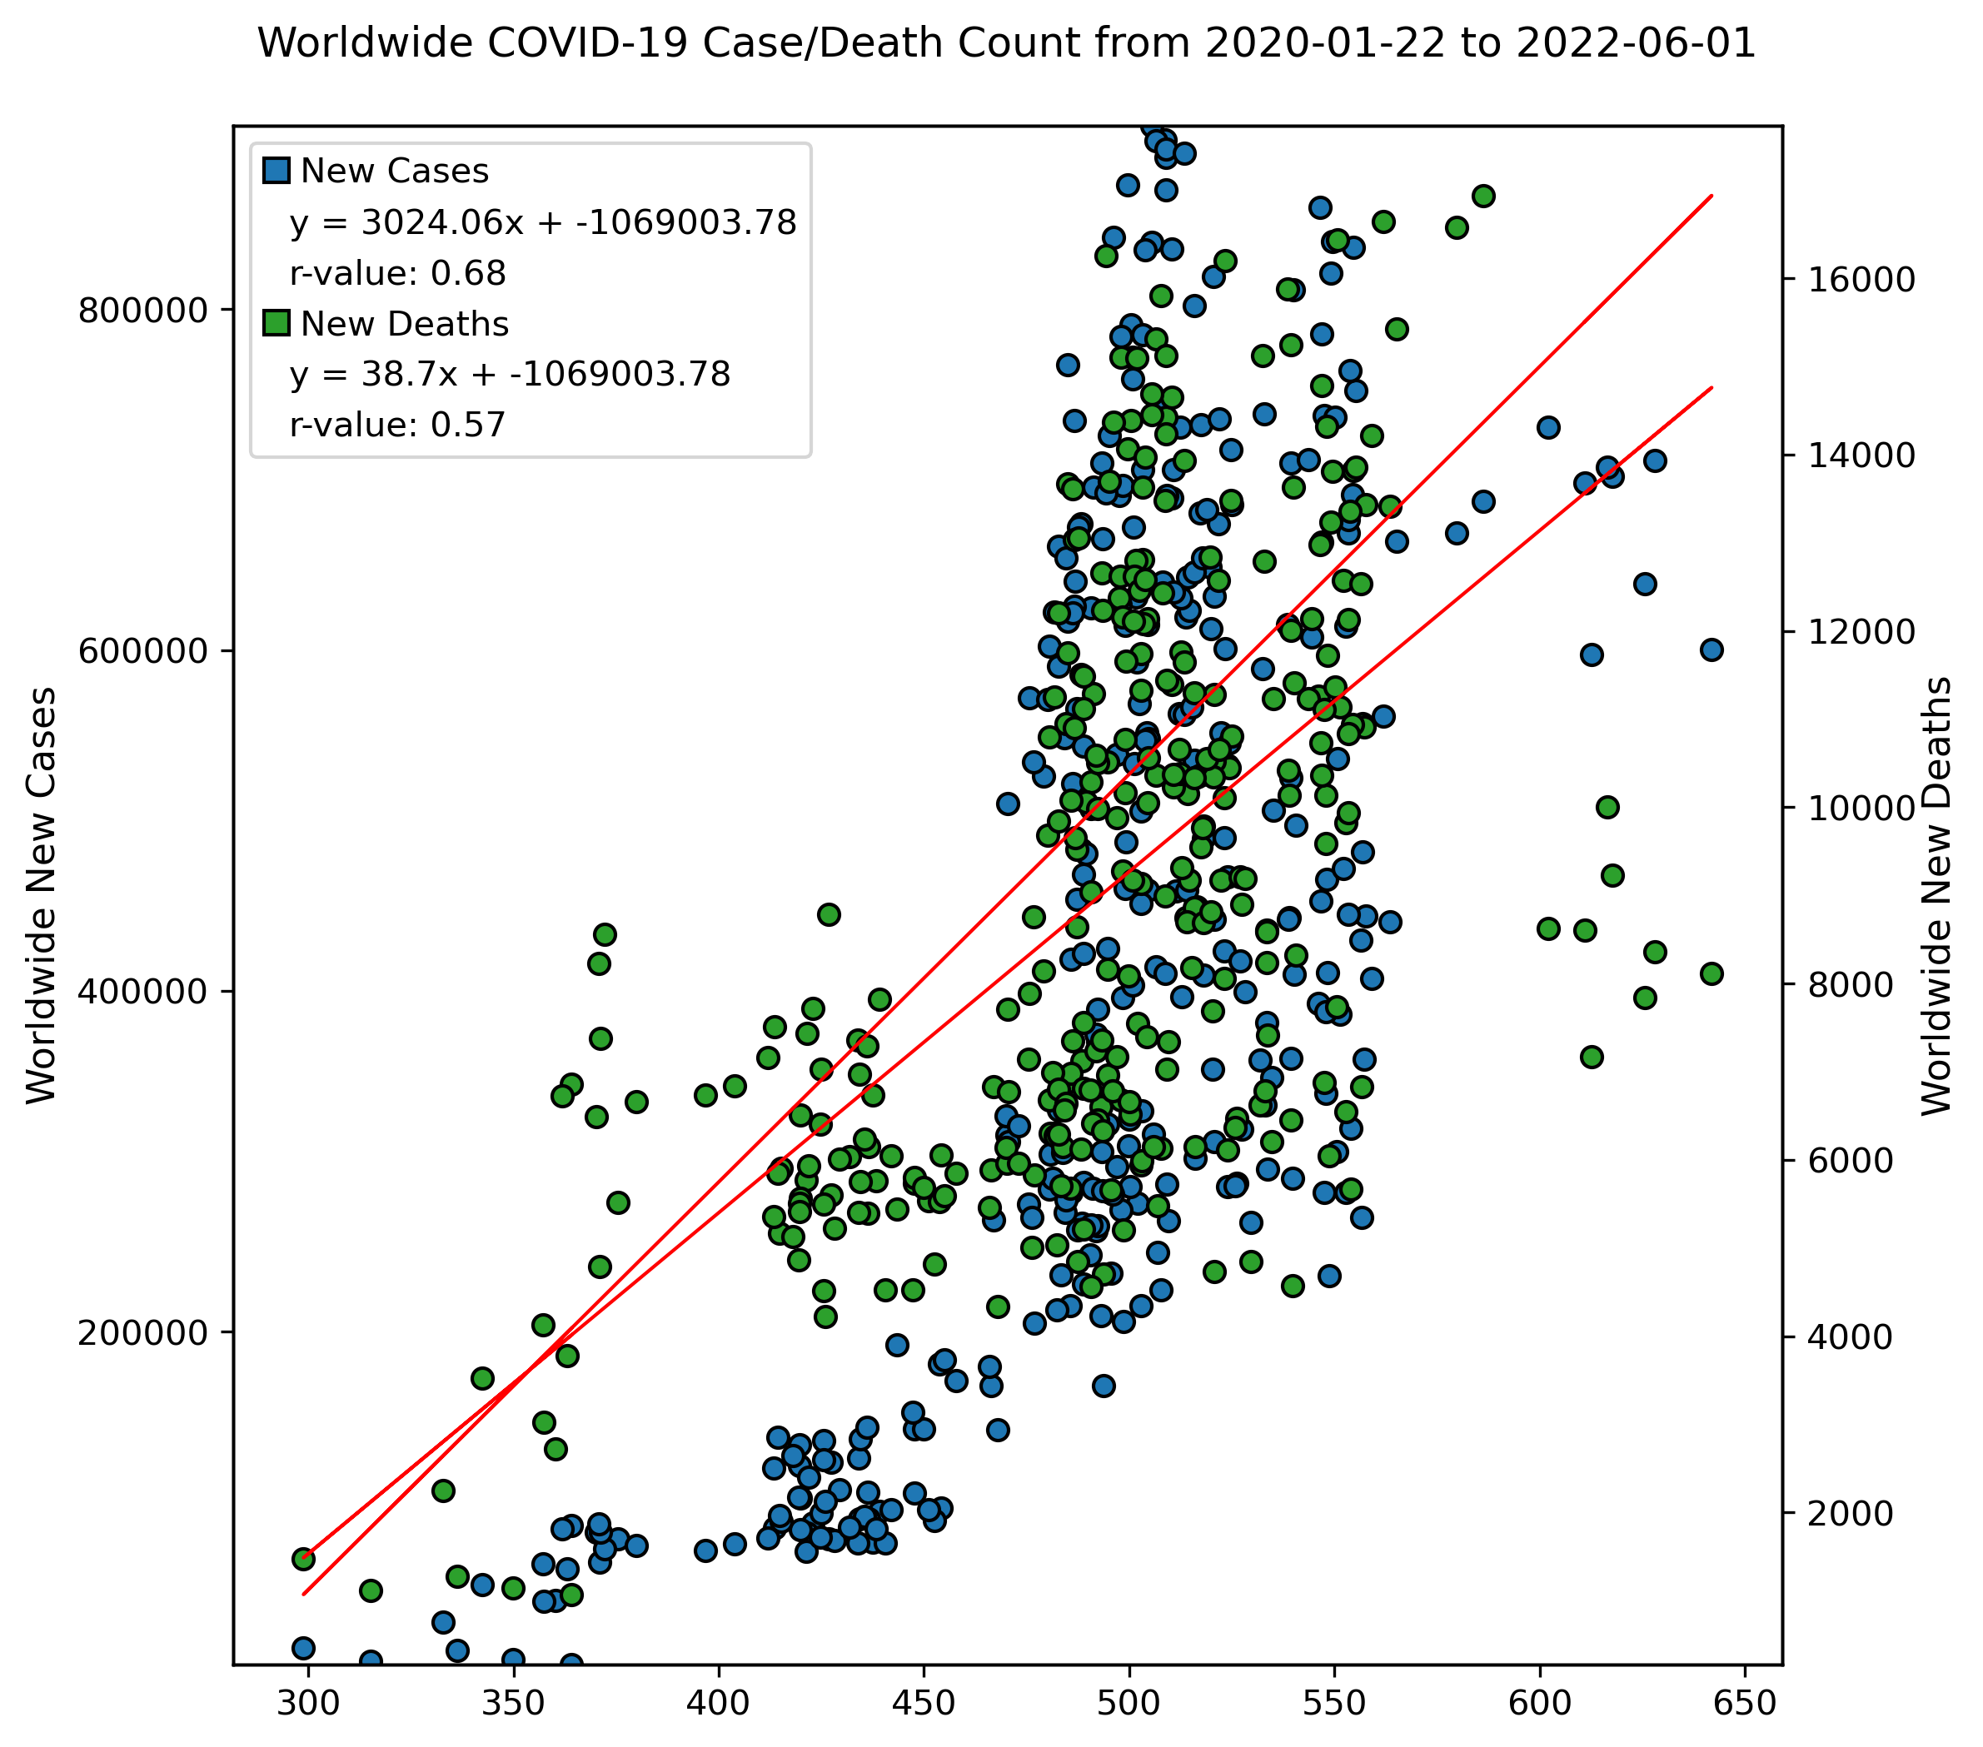
Netflix Closing Prices vs. Covid-19 (stock indicator)
3. ADX (Average directional index) Indicator
14
30
14 & 30

Slide 14
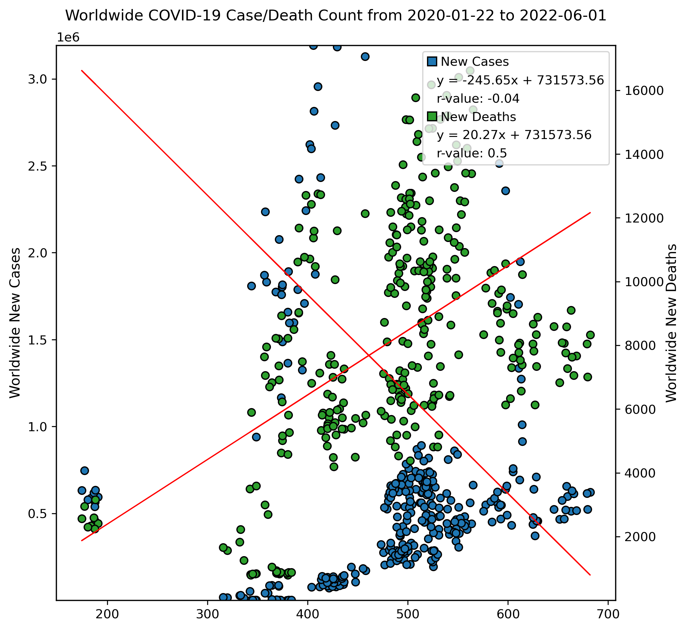
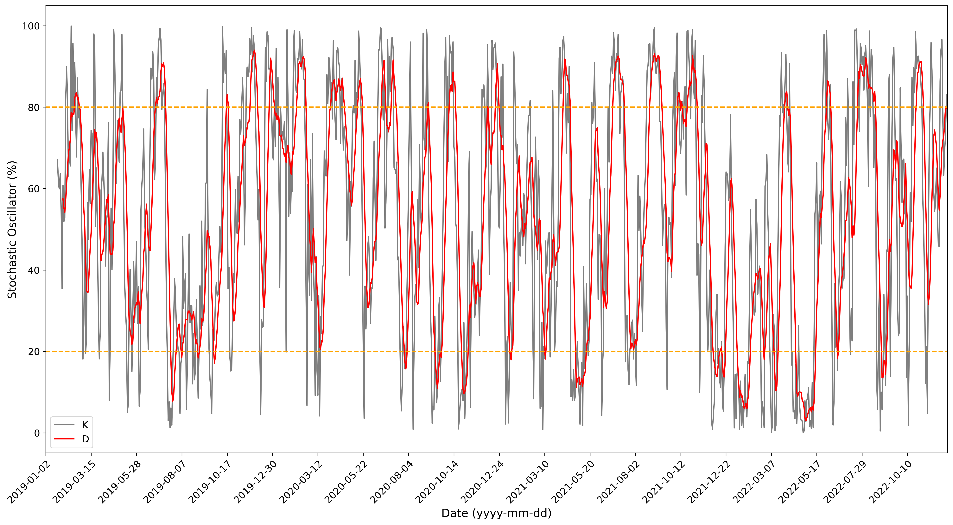
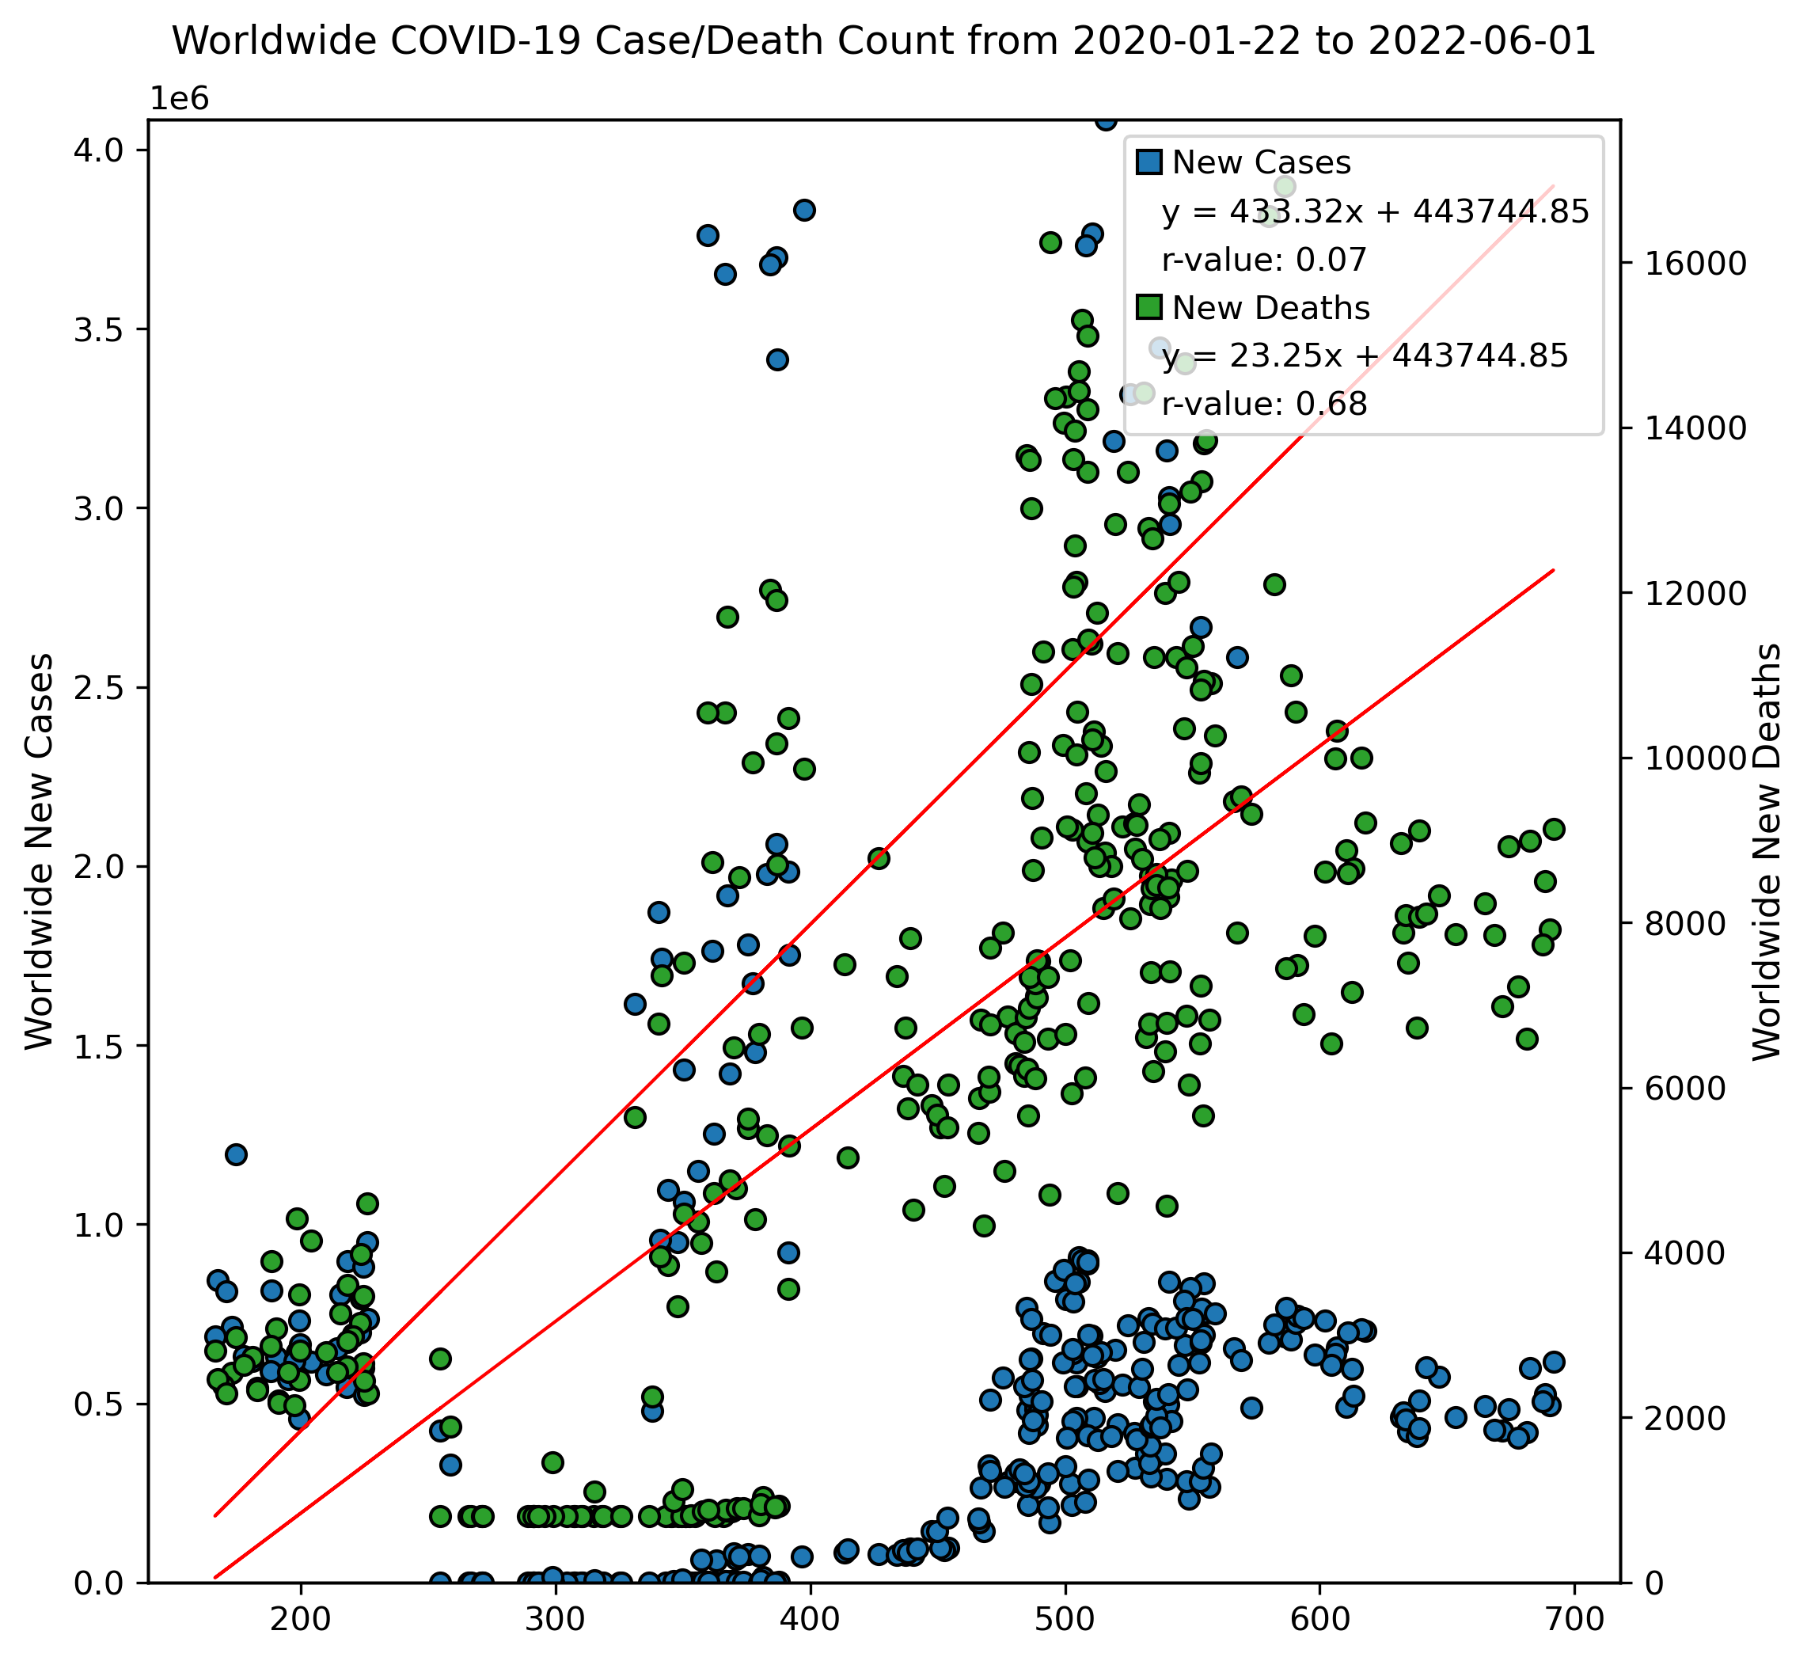
Netflix Closing Prices vs. Covid-19 (stock indicator)
4. Stochastic Oscillator
in
out

Slide 15
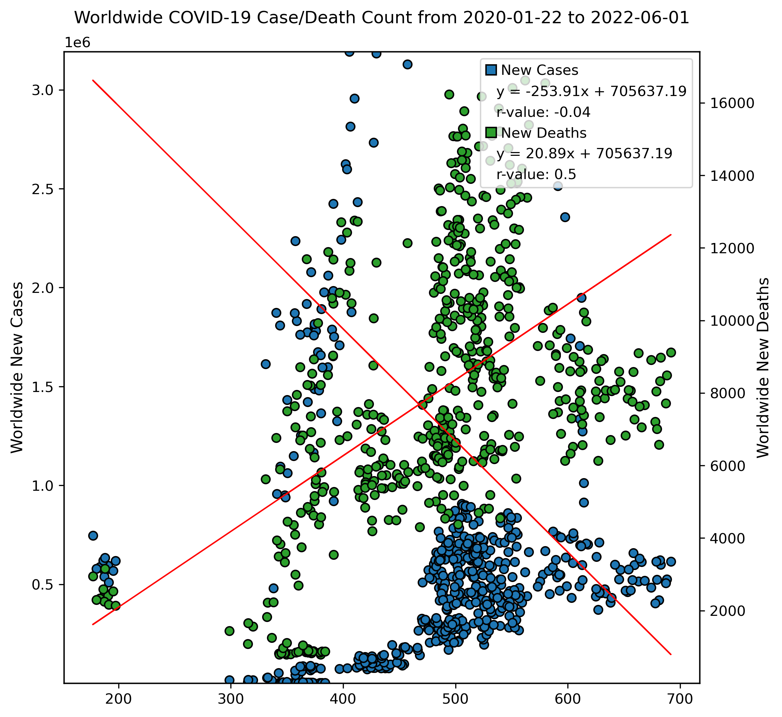
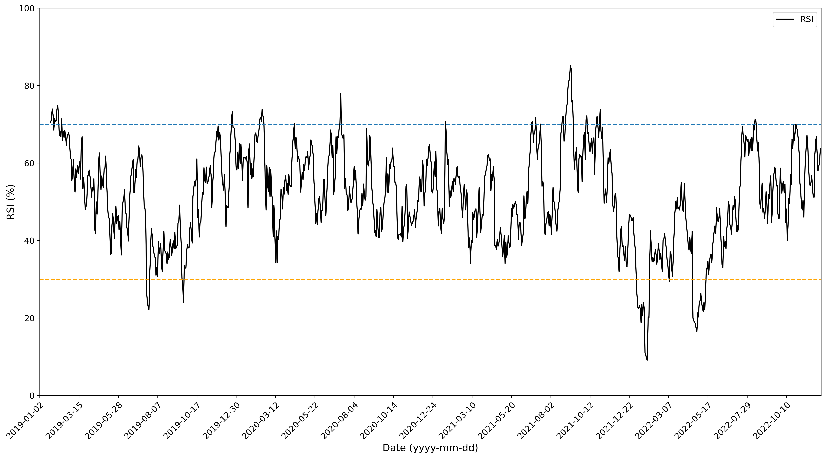
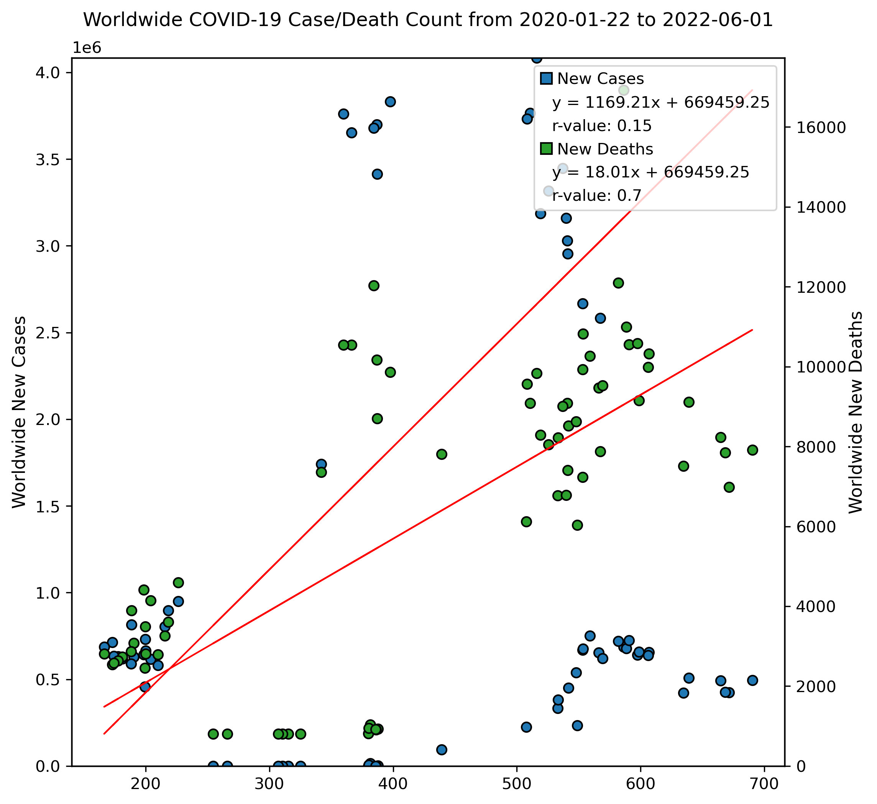
Netflix Closing Prices vs. Covid-19 (stock indicator)
5. RSI (Relative Strength Index) Indicator
in
out

Slide 16
Q1. Is there a relationship between the stock price vs. number of daily cases/death worldwide?
Q2. Is there a relationship between the stock price a week after the case count/death count vs. number of daily cases worldwide?
Q3. Is there a relationship between the stock price vs. number of daily cases/deaths by stock indicator?
Q4. Is the price movement an industry-wide trend?
compare Netflix with their main competitor Disney +
Questions

Slide 17
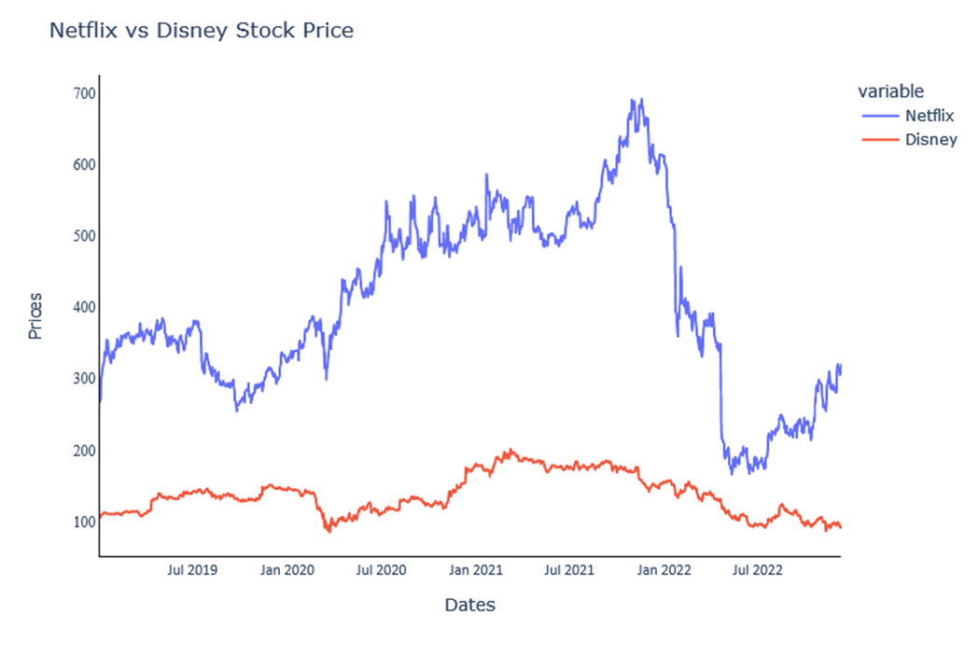
Netflix Vs. Disney +
It seems Netflix prices are always high as of Disney

Slide 18
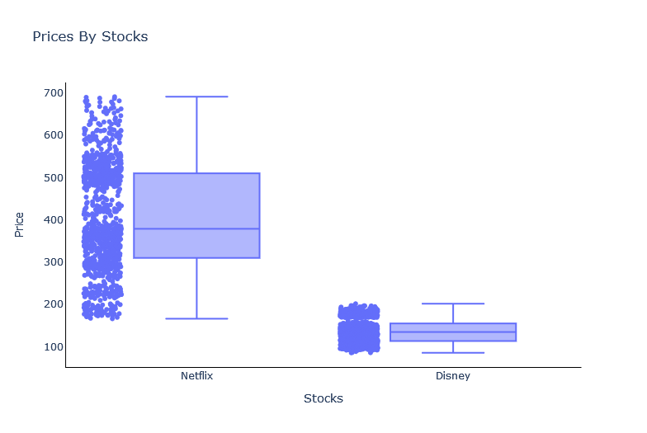
Netflix Vs. Disney +

Slide 19
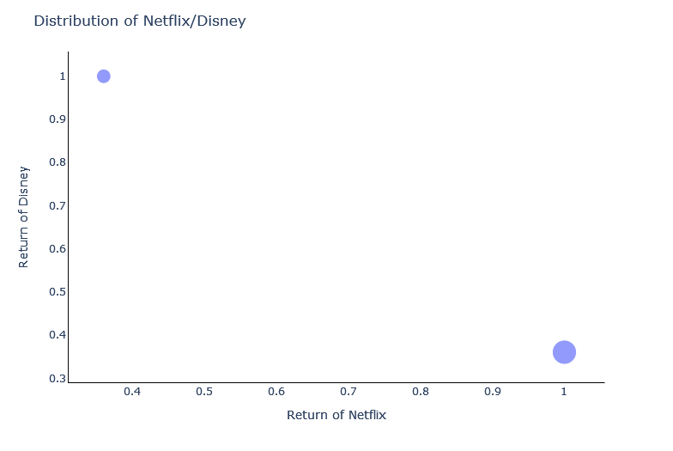
Netflix Vs. Disney +
It seems stocks are opposite related to each other, when Netflix returns are high, Disney goes down and vice versa.

Slide 20


